Slide 1
PMAC 2017 Annual Meeting
Southwest Corridor Park
Connecting Neighbors from Forest Hills to Back Bay

Slide 2
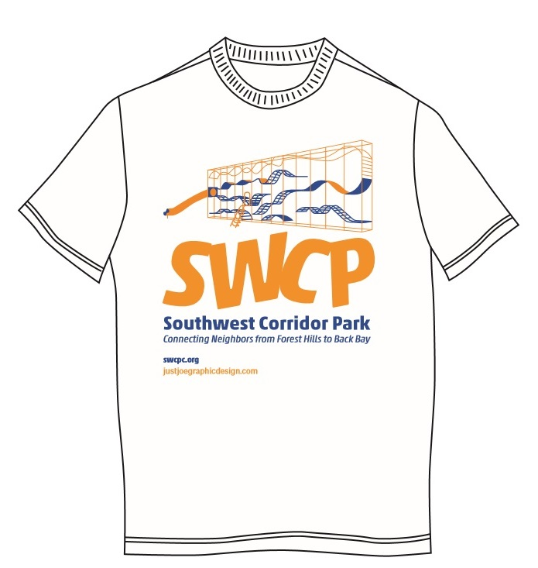
Park Volunteers / Stewards Gardening and Landscaping

Slide 3
Park Stewards / Volunteers
Over 1,500 volunteer hours
Approximately 25 locations in the Southwest Corridor Park, in the South End / Back Bay, Jamaica Plain/Stony Brook/Green Street/Forest Hills and Jackson Square.
Volunteers work in small groups, on their own, and in volunteer day groups, throughout the four seasons.
Park Stewards / Volunteers
Gardening & Landscaping

Slide 4
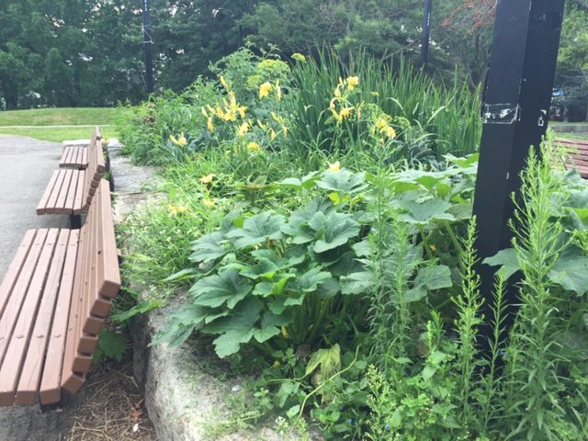
Park Stewards / Volunteers
Gardening & Landscaping
We continue a theme of both edible landscaping and use of native plants. Featured here – the Festival Garden in JP.

Slide 5
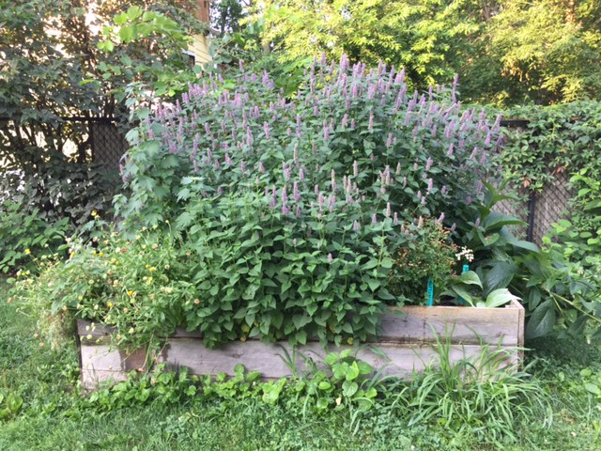
Park Stewards / Volunteers
Gardening & Landscaping
Now in its second year – the Herbstalk garden is a raised bed demonstration garden featuring herb plants.

Slide 6
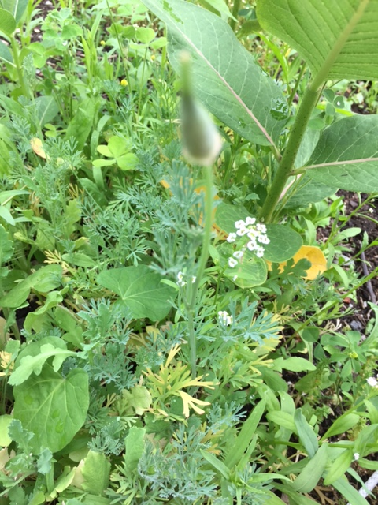
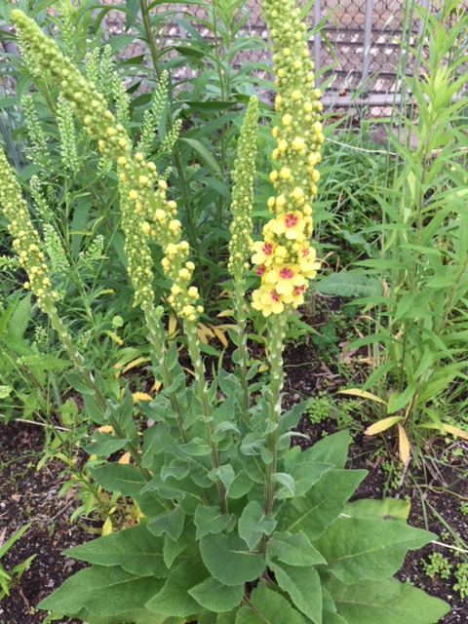
Park Stewards / Volunteers
Gardening & Landscaping
JP Butterfly Garden

Slide 7
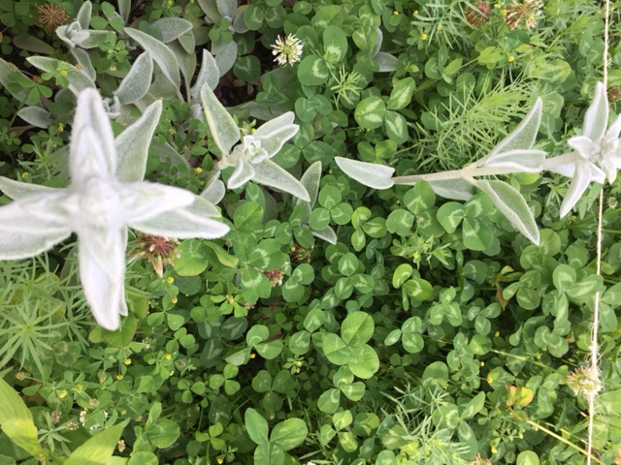
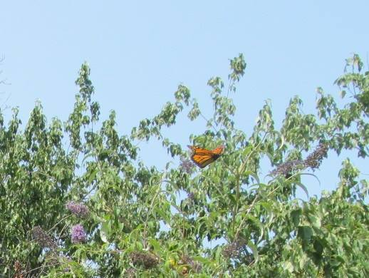
Park Stewards / Volunteers
Gardening & Landscaping
The addition of the JP butterfly garden gives us two gardens focused on butterfly plants. Featured here – a release of a newly-emerged monarch in the garden near Mass Ave.

Slide 8
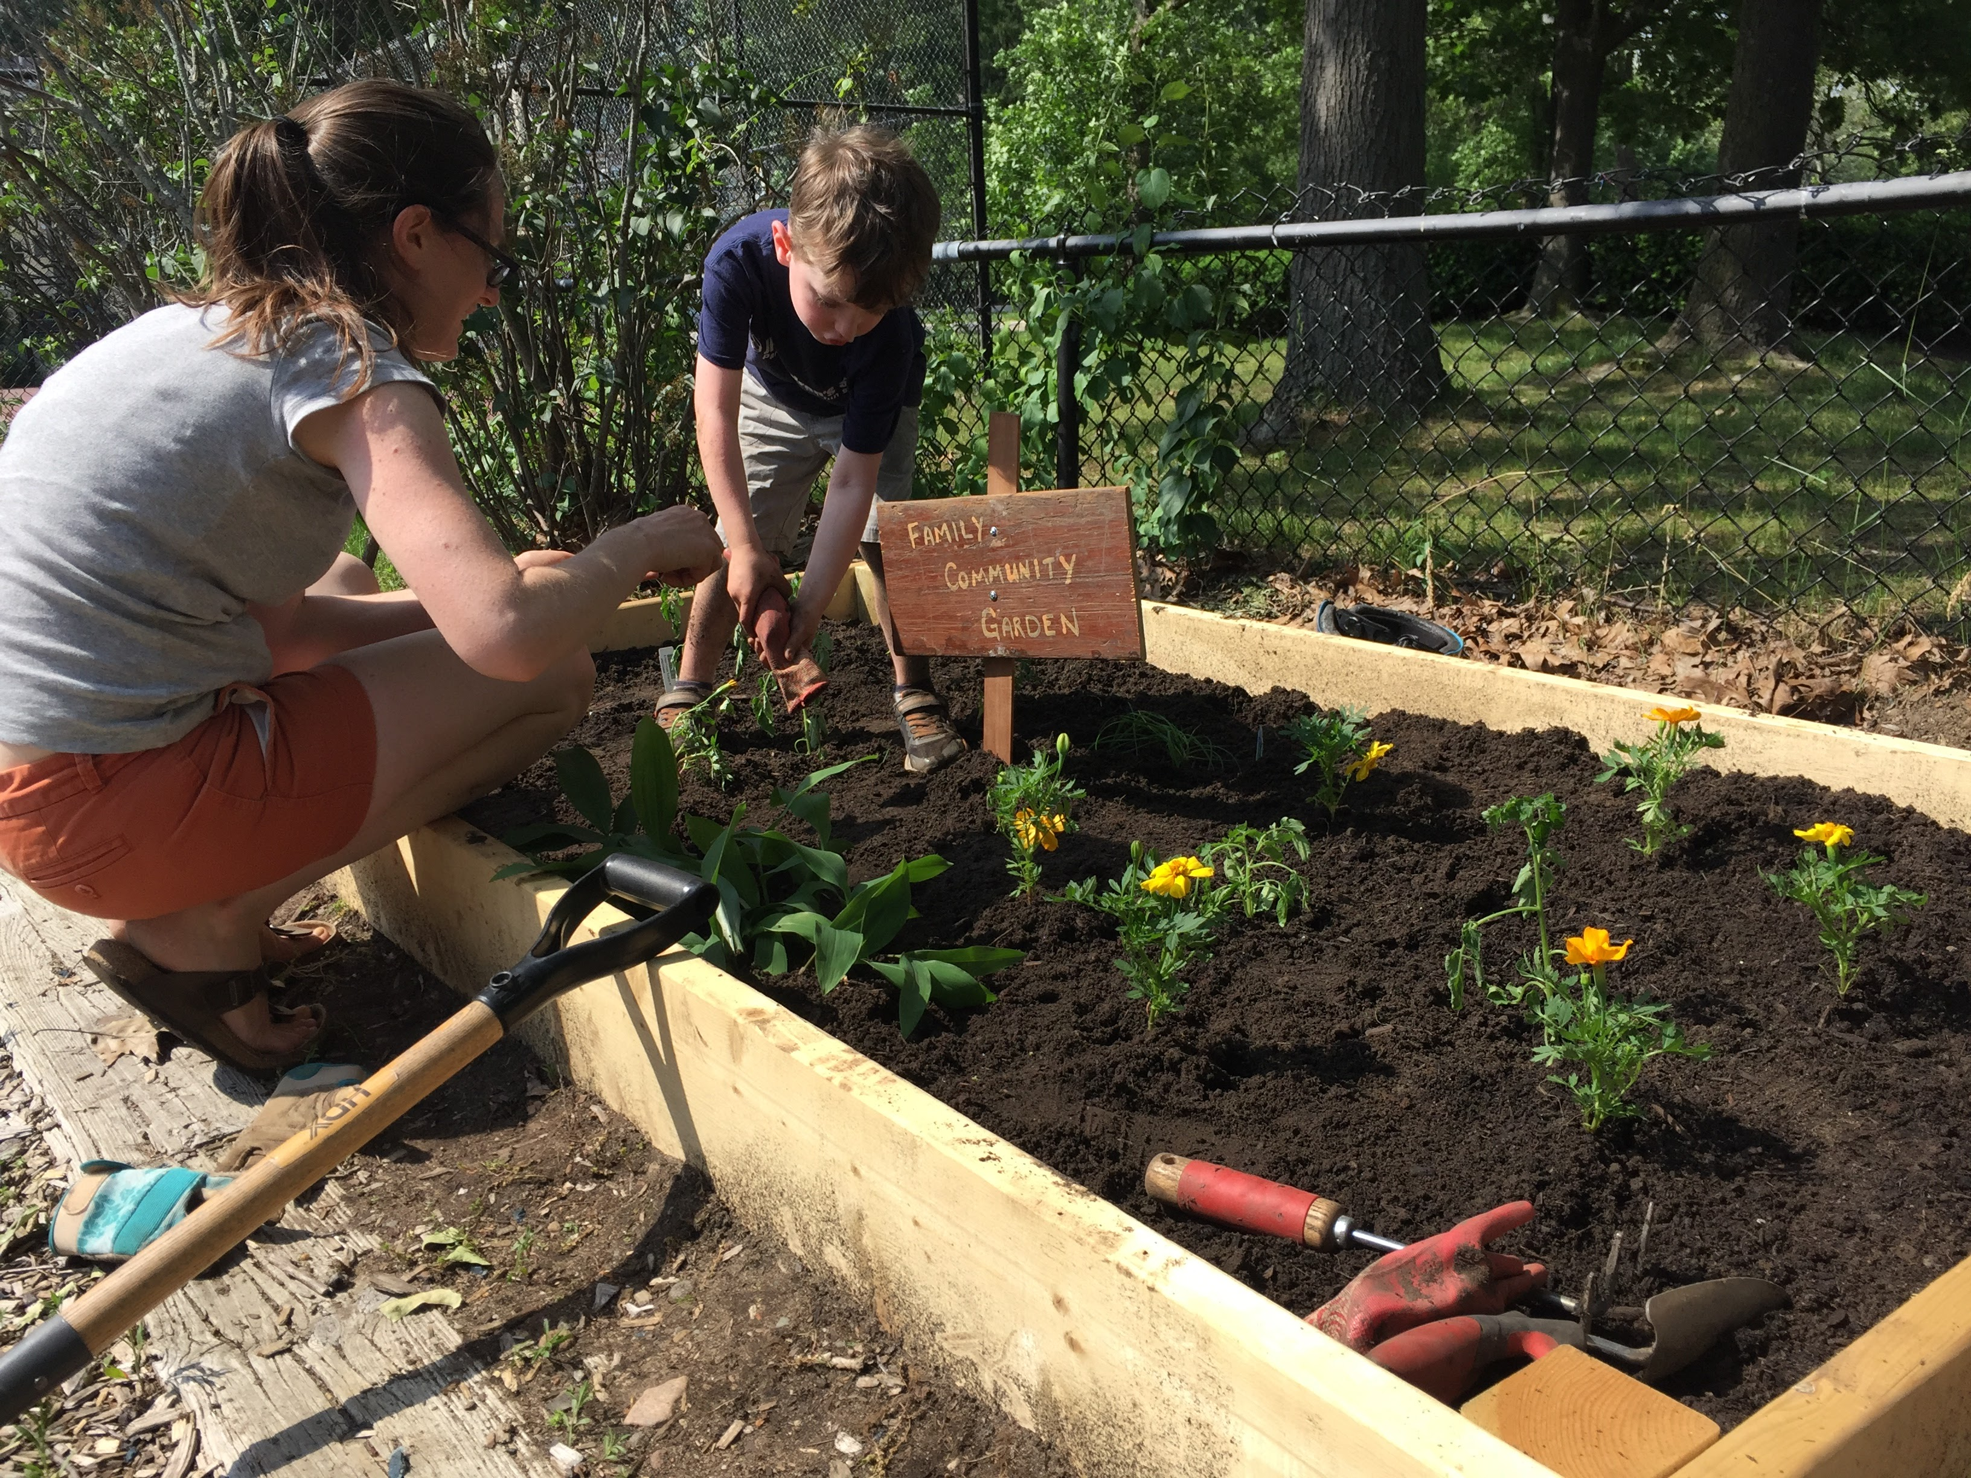
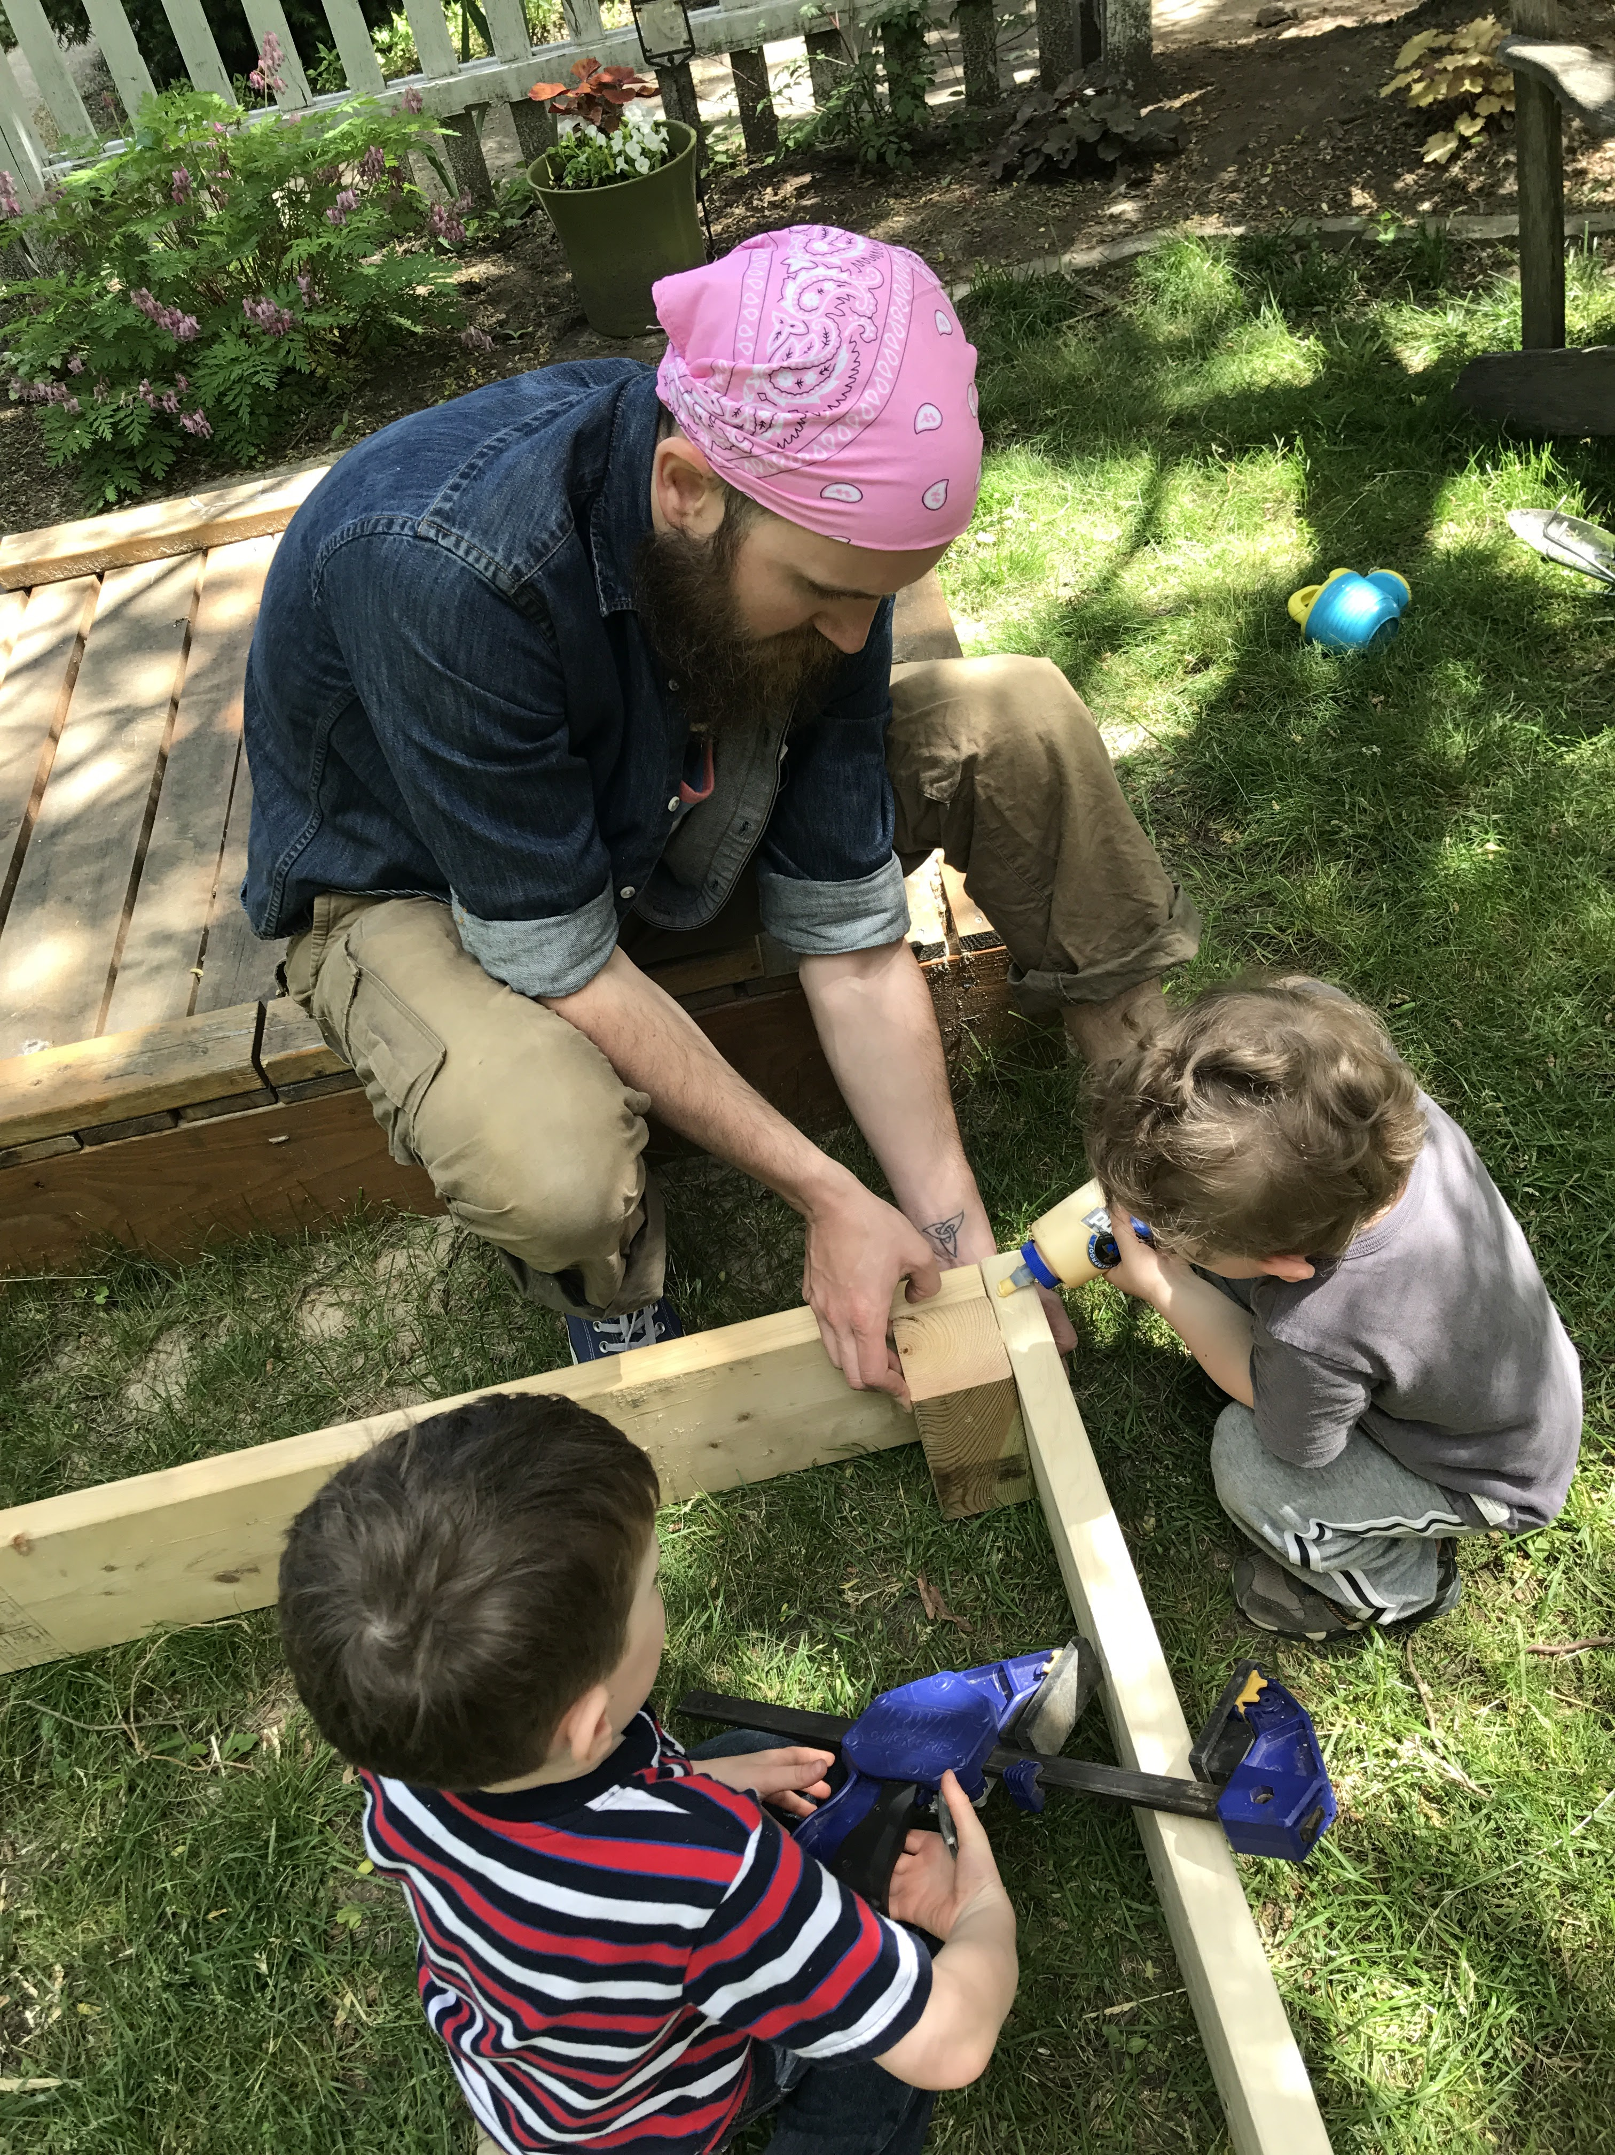
Family Community Garden –
At New Minton Street Playground

Slide 9
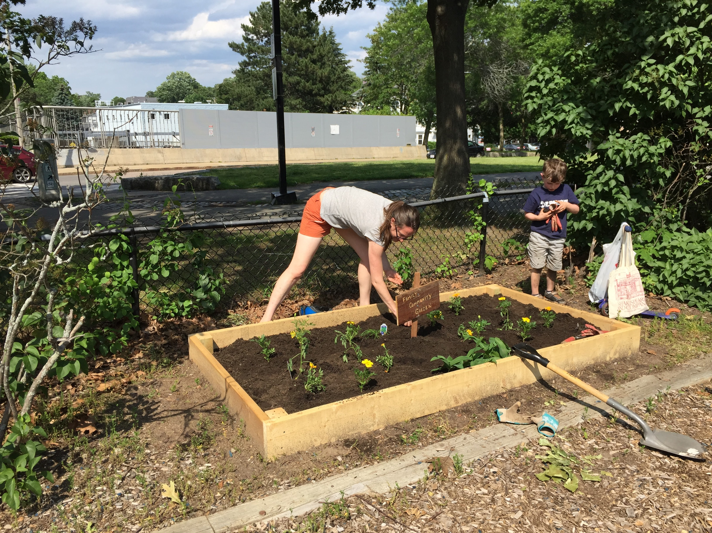
Family Community Garden –
At New Minton Street Playground

Slide 10
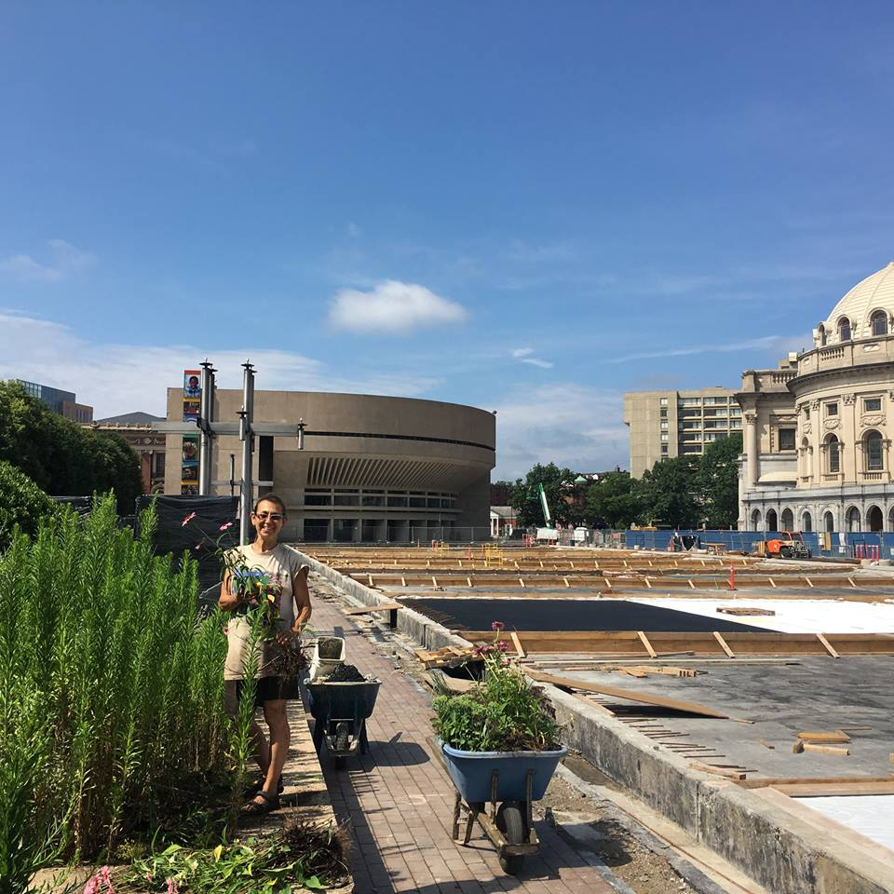
A volunteer highlight this summer: One of our volunteers made a connection between the SWCPC and the project managers of the Christian Science Plaza renovation project. Since the nearby Christian Science Church is repairing and restoring the Christian Science Plaza, they donated perennials from their gardens to the Southwest Corridor Park Conservancy. One Saturday morning in July, the neighborhood was dotted with gardeners and wheelbarrows full of plants, transporting plants to the park. These plants are now found in gardens around the park, as very welcome additions to the landscape.

Slide 11
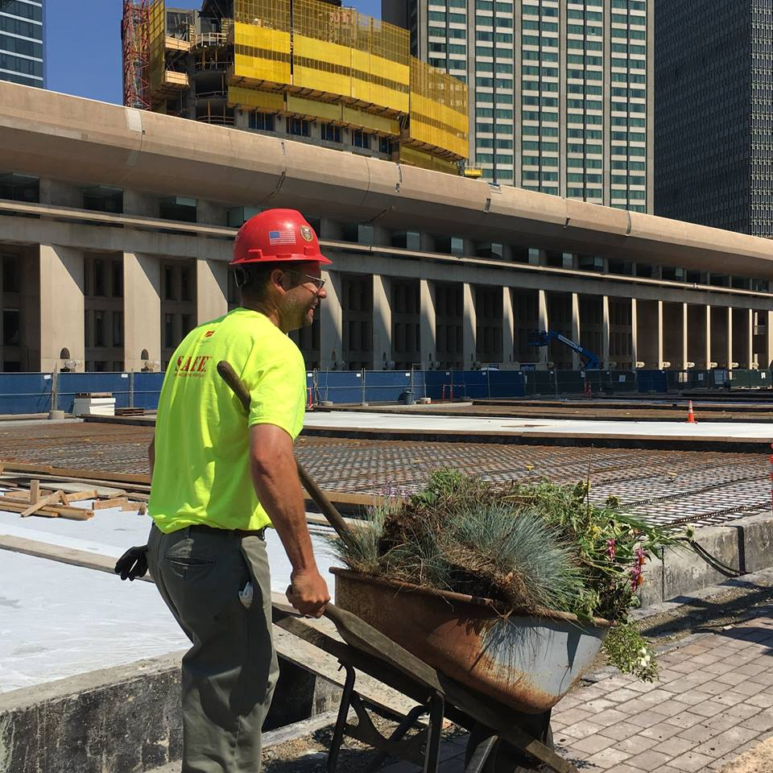
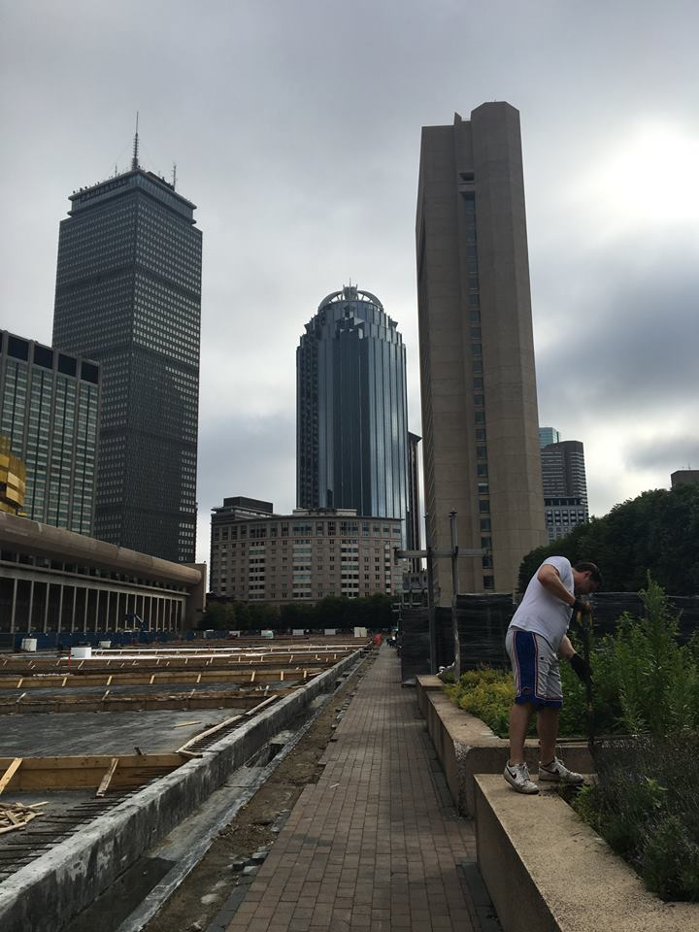
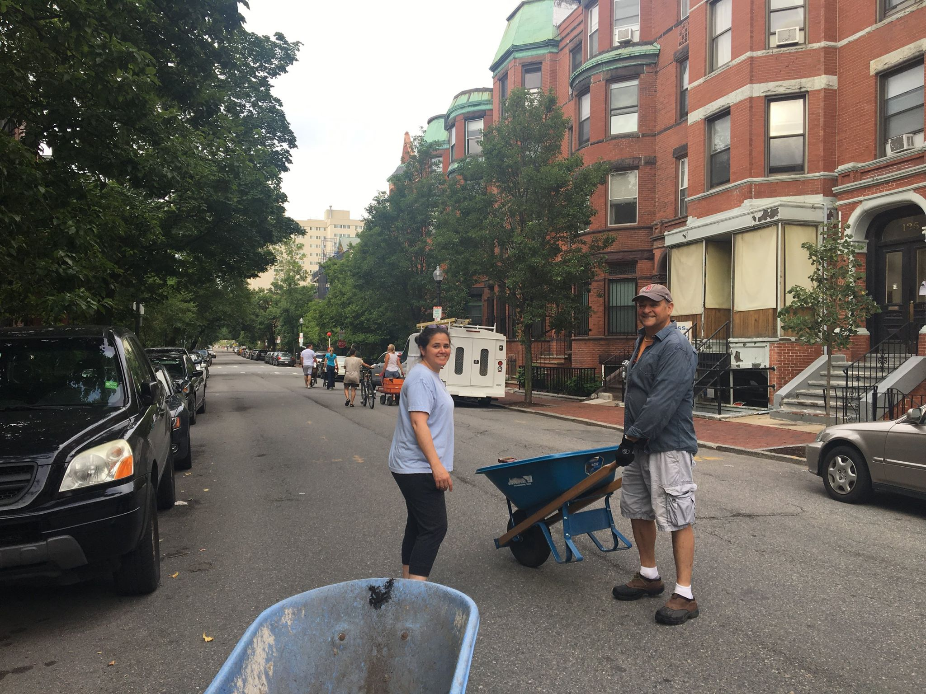
Plant Donation from the Christian Science Plaza Project

Slide 12
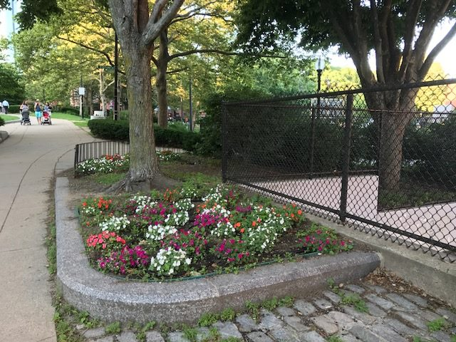
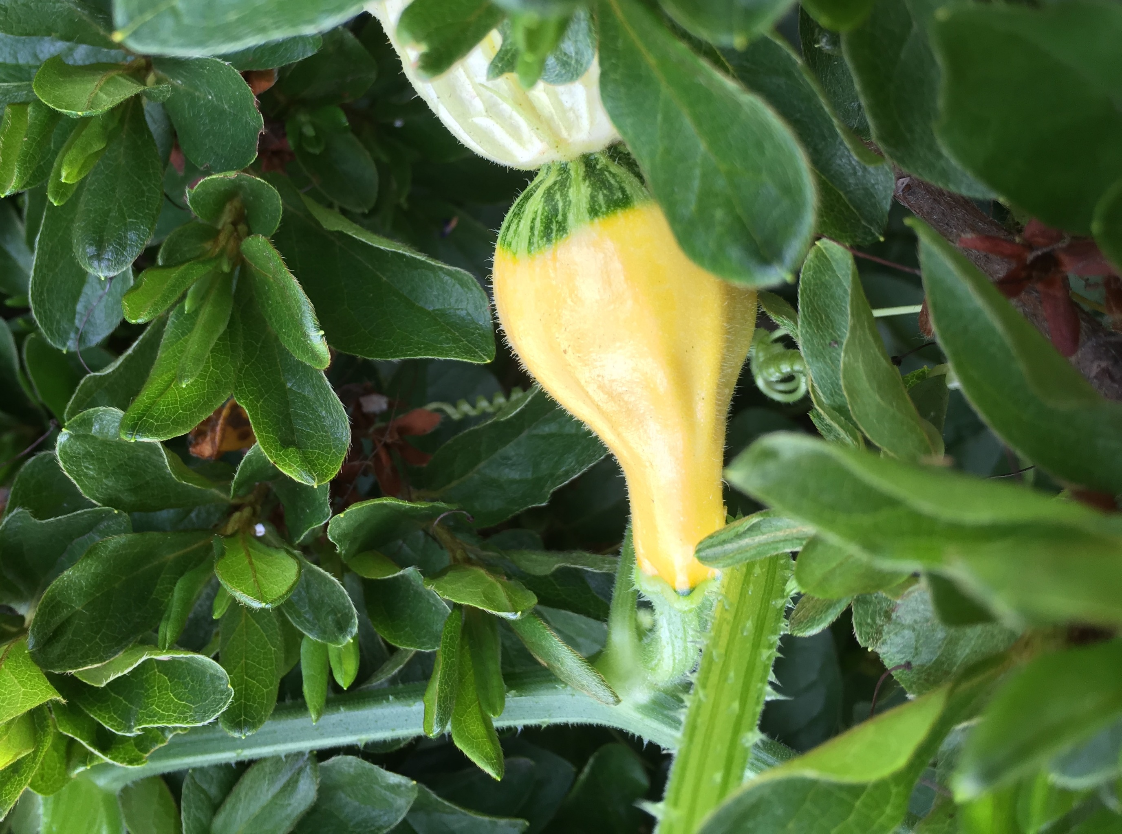
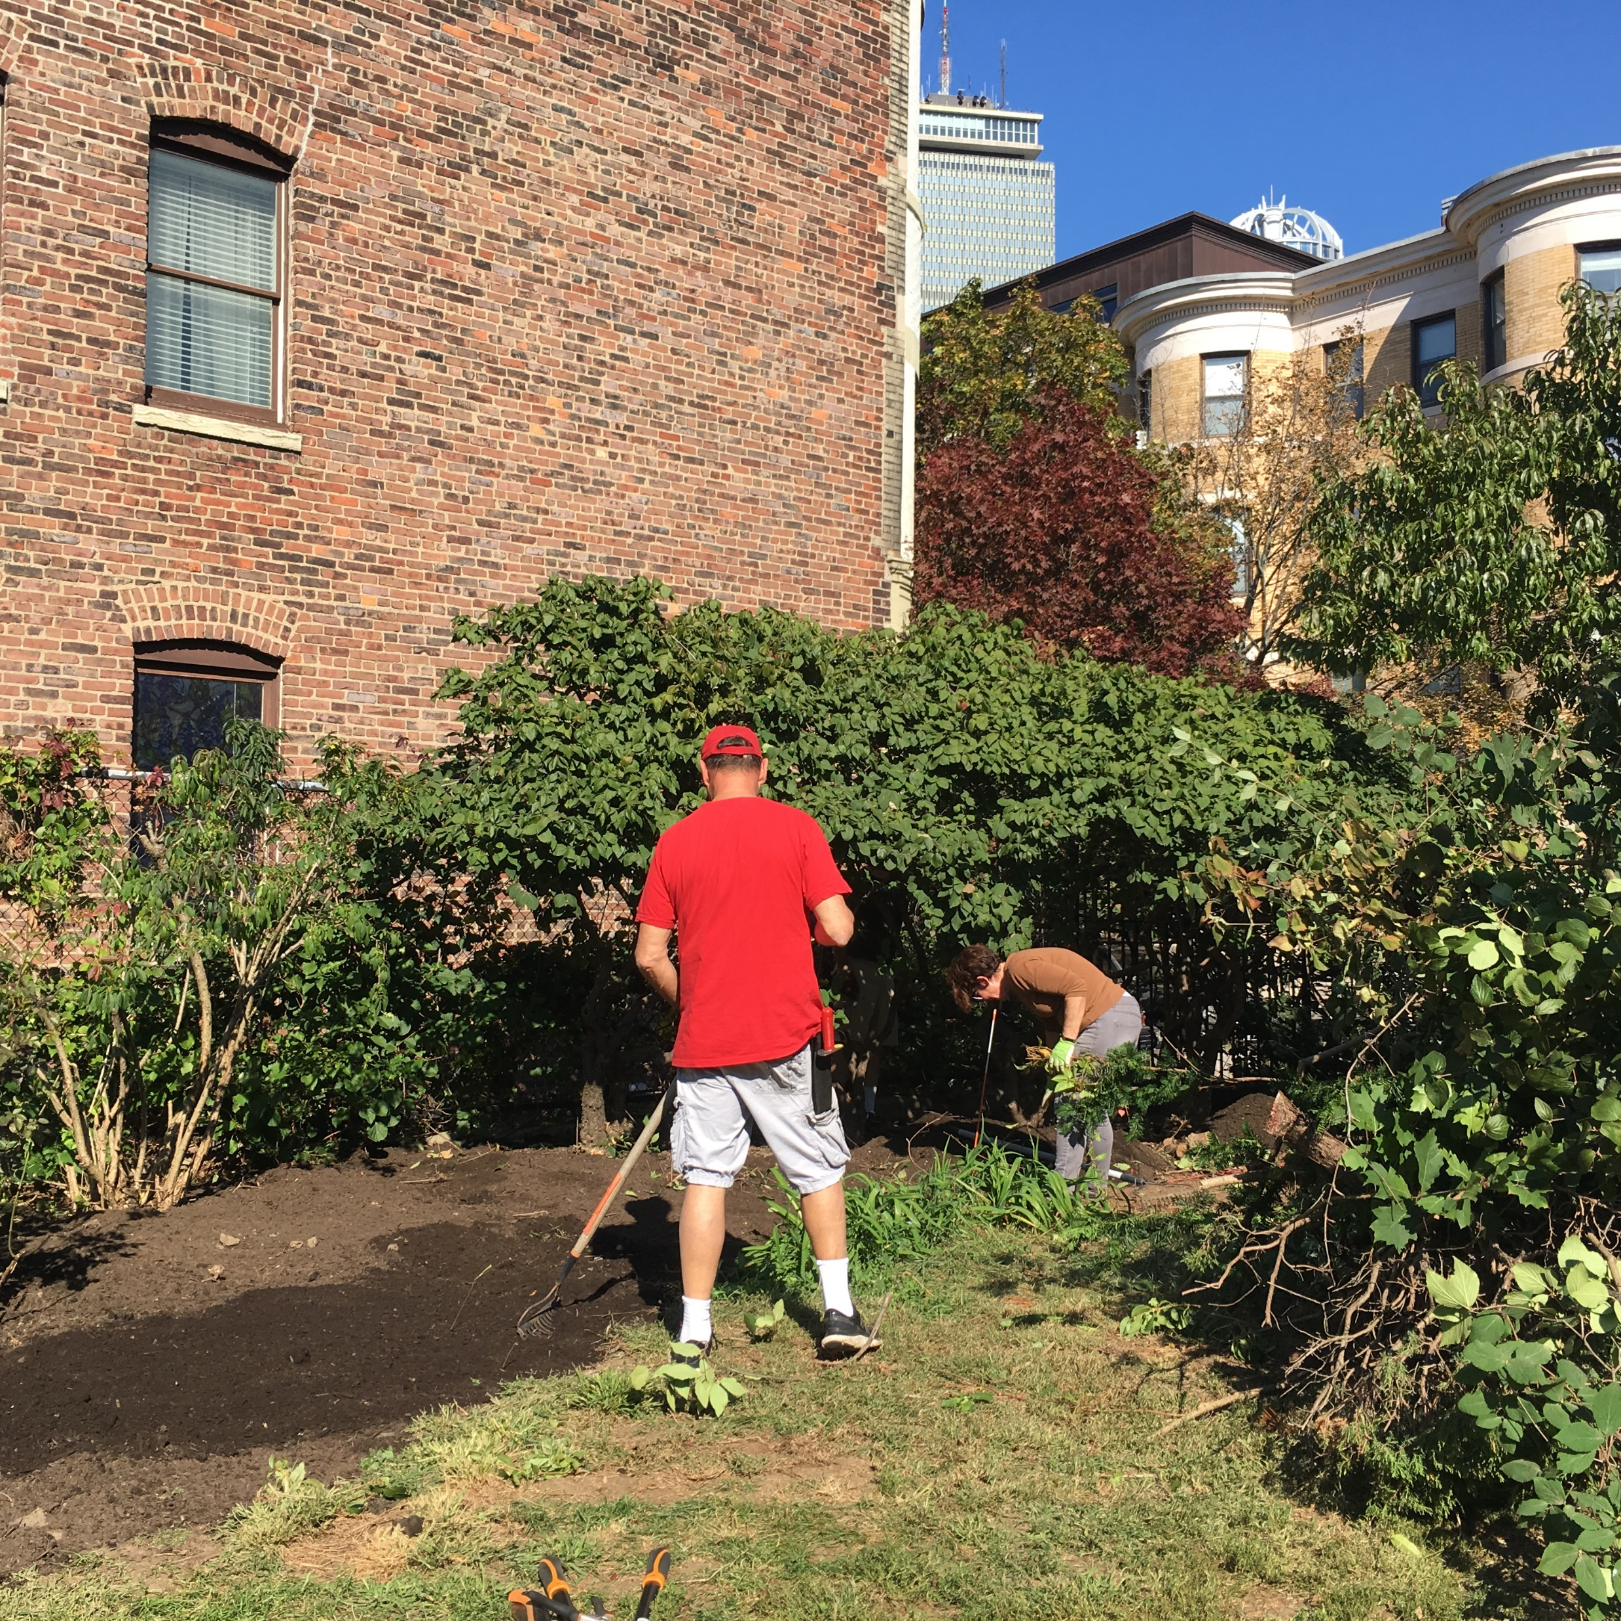
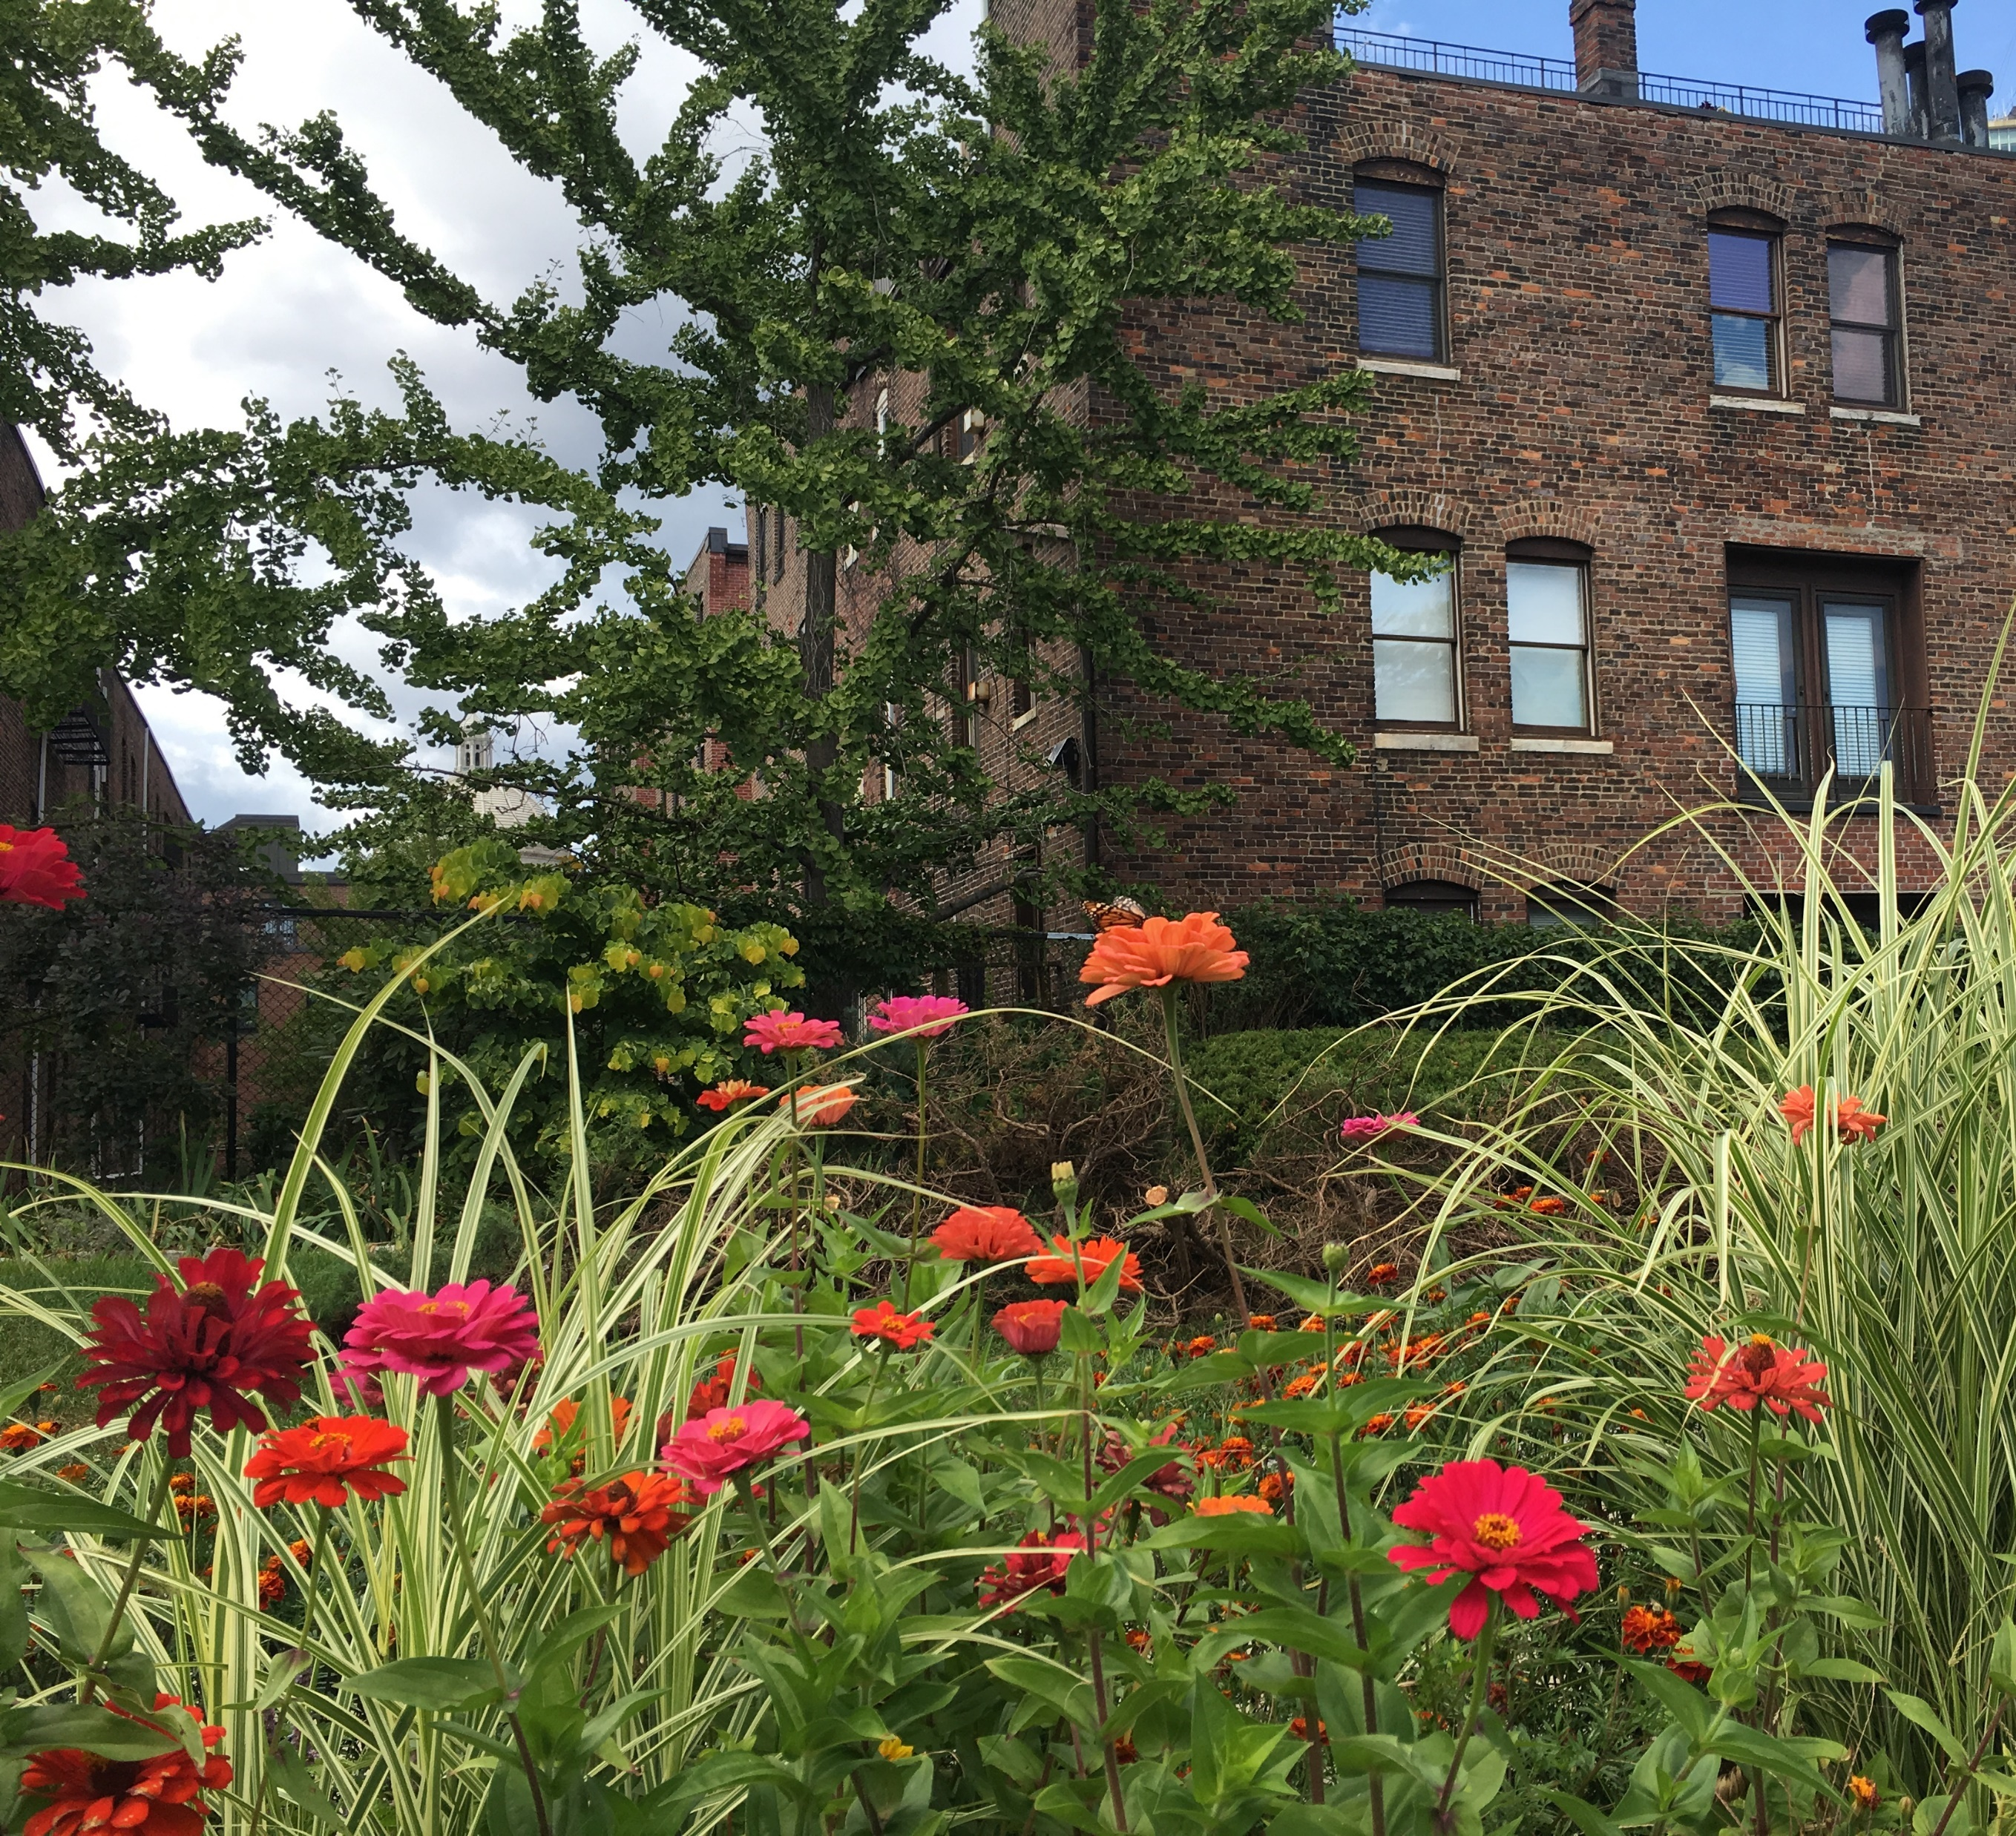
SWCPC volunteers, including neighborhood volunteers, BostonCares, Northeastern University, the Marriott Hotel and many school and corporate groups, provided over 1,500 hours of volunteer service so far this year.

Slide 13
Hymn to the Park - the Southwest Corridor
By Curtis Mitchell
What do you have to gripe about?! Things are mostly like days of yore Along the Southwest Corridor. Hand-in-hand they traipse in galore Showing love, showing affection - Along the route of the Southwest Corridor. Adults and children riding on all sorts of wheels - and more, Along the Southwest Corridor. Bands, picnics, frolic like never done to the core All this along the Southwest Corridor. Here a dog, there a dog, some big, some small - what more? Along the Southwest Corridor. Flowers and plants - some never even seen before - Exotic, mundane, all Over the Southwest Corridor. Little babes riding in strollers and more With laughs, giggles by the score . . . . It can and does go on and on within this dreamland park Called the Southwest Corridor.
Curtis Mitchell shared this poem with SWCP volunteer, sharing also that he is currently homeless and considers the Southwest Corridor Park a favorite place to be. As much as Bostonians often gripe about city living, this poem is a thoughtful "hymn" to the neighborliness found within the park.
Park Stewards / Volunteers
Gardening & Landscaping

Slide 14
Youth and Family Programming

Slide 15
Youth and Family Programming
For the second summer, the Southwest Corridor Park Management Advisory Committee, in partnership with Northeastern University and the Southwest Corridor Park Conservancy sponsored six mini-grants to support youth and family programming in the Southwest Corridor Park.
Children’s Garden in Jackson Square
Family Community Garden in New Minton Street Playground
Formal and informal connections with other youth programs.
Youth and Family Programming

Slide 16
Mini-Grants – With Northeastern University and the Southwest Corridor Park Conservancy
Art supplies for the USES Children's Art Center's "Paint Outs" in the Southwest Corridor Park
Printing for IBA's "Exploring Community" book authored by children in their summer program
Expenses for Boston Explorer program's bicycle exploration of the Southwest Corridor Park
Materials for Wee the People's special event at JP Porchfest, featuring history of community action
Instructor stipends and supplies for Mildred Hailey Tenants Association's (Bromley Heath) Mom-and-Me programming and explorations in the park
Zumba-with-the-police, sponsored by Tree of Life/Arbol De Vida, with BPD E-13.

Slide 17
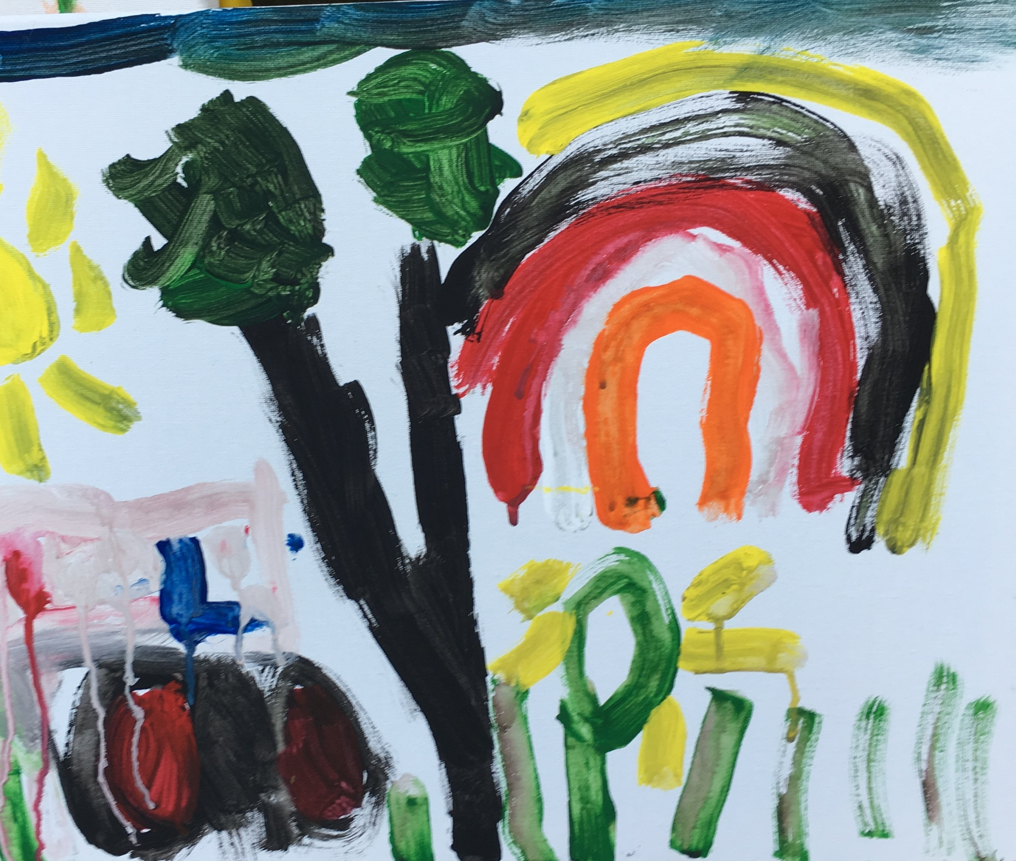
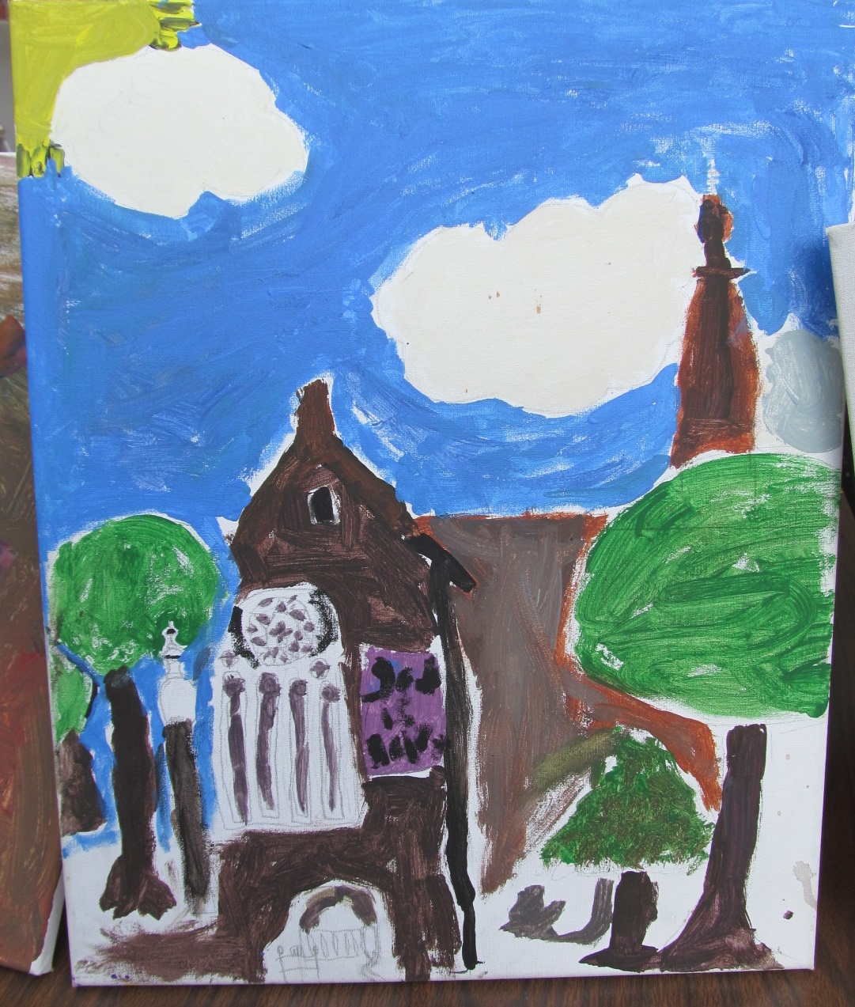
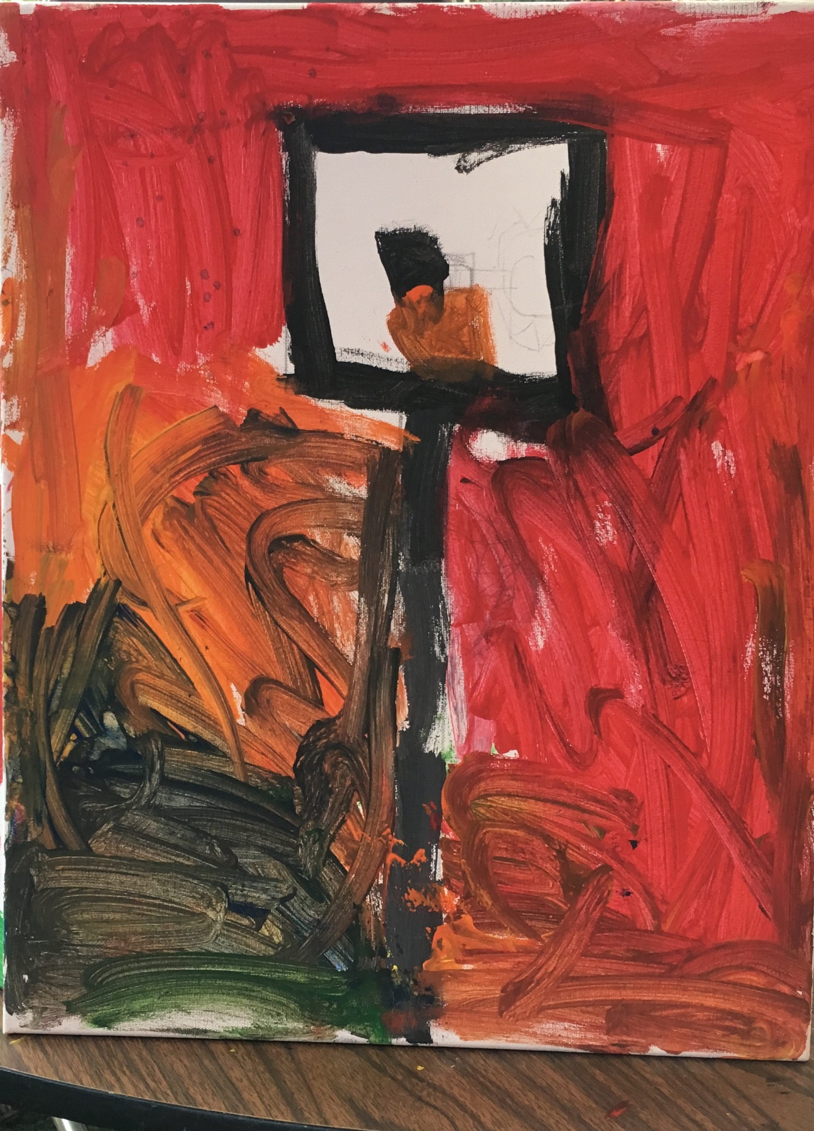
USES Children's Art Center's "Paint Outs"
USES staff report that children wore our new SWCP tee-shirts on a scavenger hunt along the corridor, from Titus Sparrow Park culminating in lunch at BPL / Copley Square. People in the park noticed the tee-shirts and asked the leaders about their connections with the park.

Slide 18
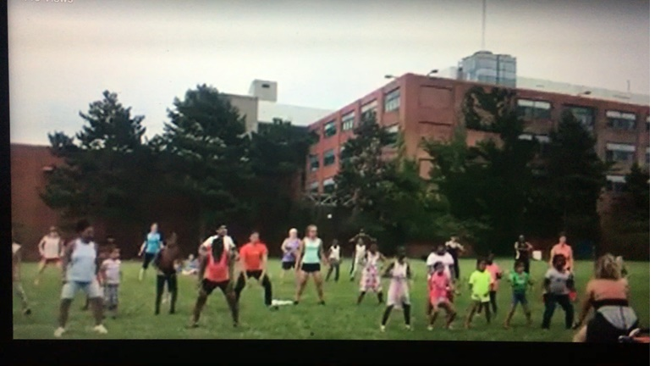
Zumba with the Police
Zumba class in the field near English HS led by an E-13 Community Service Officer and coordinated by Arbol de Vida/Tree of Life.
BPD leadership joined the group one evening, with the Commissioner and other BPD leadership, state police, new BPD cadets, along with the new BPD ice cream truck.

Slide 19
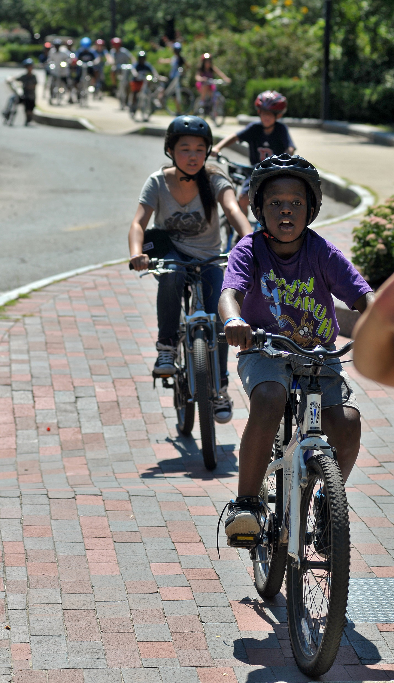
Boston Explorers – Urban Camp for Kids
Our first ever, Boston Explorers Bike Week was a huge success and thanks, in part to our friends at Southwest Corridor Park Management Advisory Council. Your mini-grant helped fund this new initiative. As we shared in our grant application, at Boston Explorers we are committed to enrolling youngsters from families with limited resources. Our goal is to explore Boston by foot, T, bike and boat.
We believe all children should have full access to Boston—its history, culture, natural, and commerce-rich resources. In doing so, we give kids a greater shot at being active citizens and stewards of our city.
For your generosity, your community spirit and for helping to make our city a place where all kids thrive and succeed. Thank you. We are grateful for your support.

Slide 20
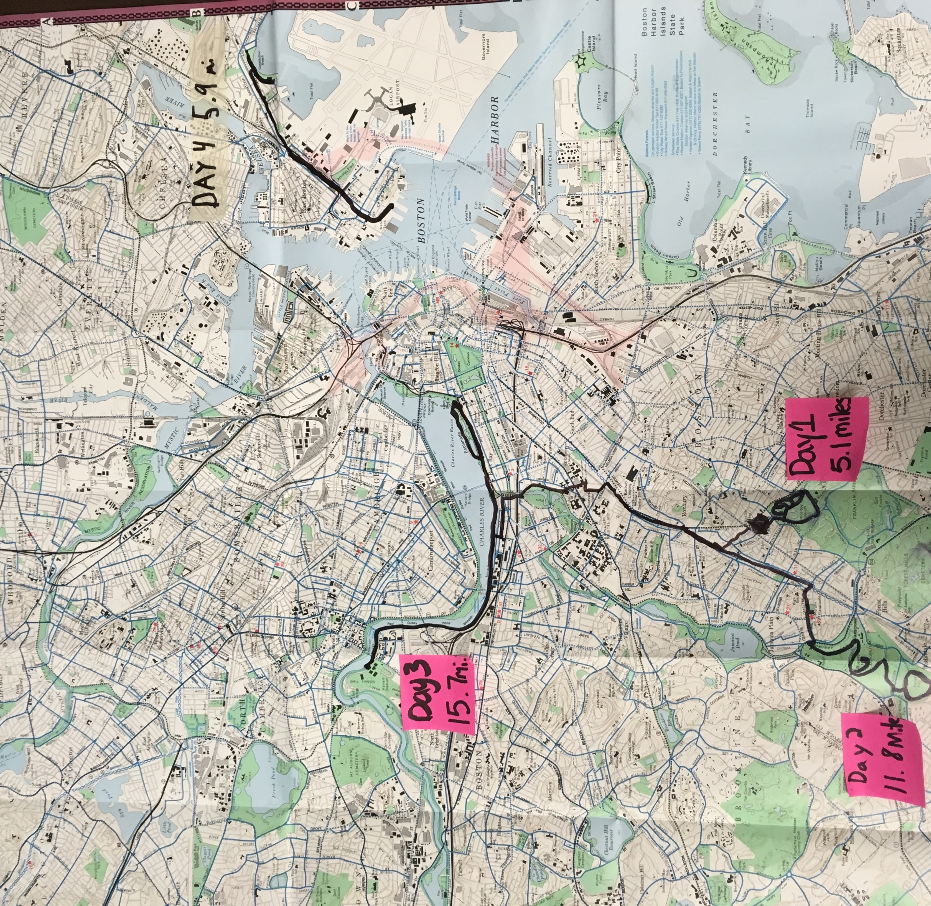
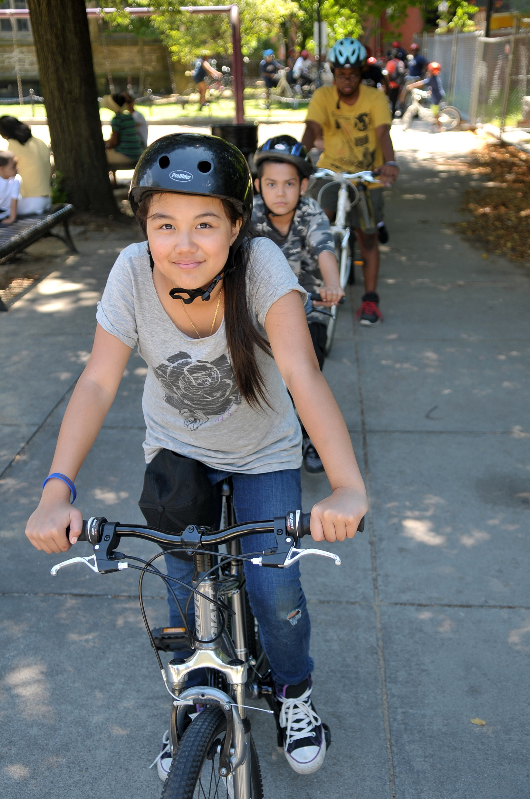
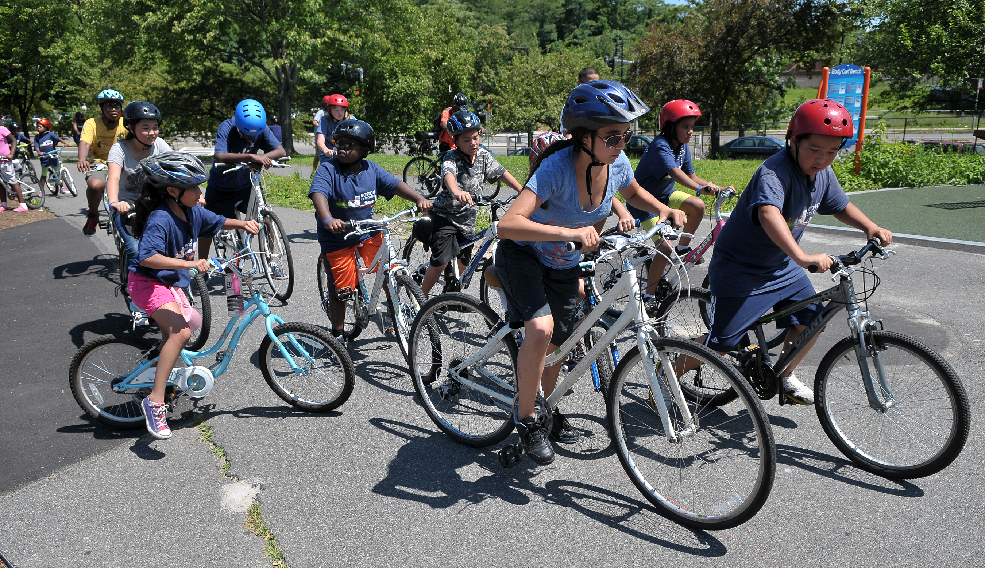
Boston Explorers – Urban Camp for Kids

Slide 21
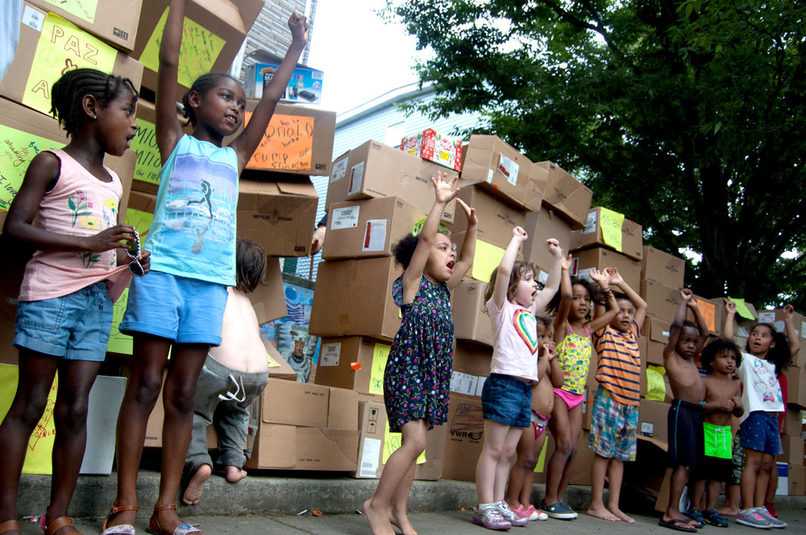
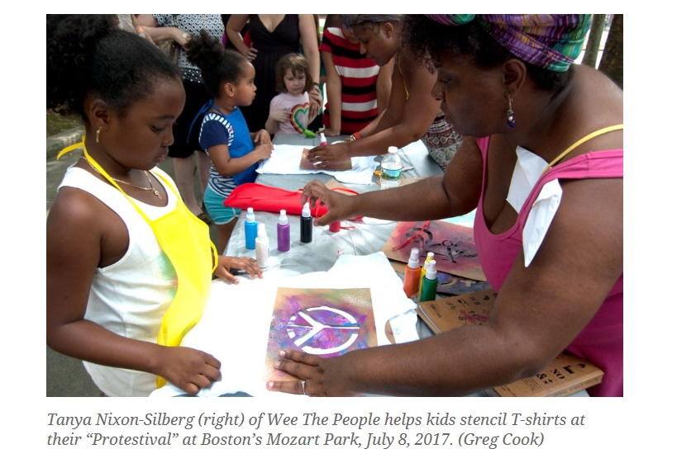
Wee the People – At JP PorchFest
Wee The People is a social justice project that engages kids around social differences, injustice, and protest through art workshops and interactive games. JP Porchfest 2017 marked the second installment of Protestival!; this summer we were fortunate to be hosted by Mozart Park with the support of The Southwest Corridor PMAC grant and Hyde Jackson Square Main Streets, whose constituency includes a large and vibrant Latinx community.

Slide 22
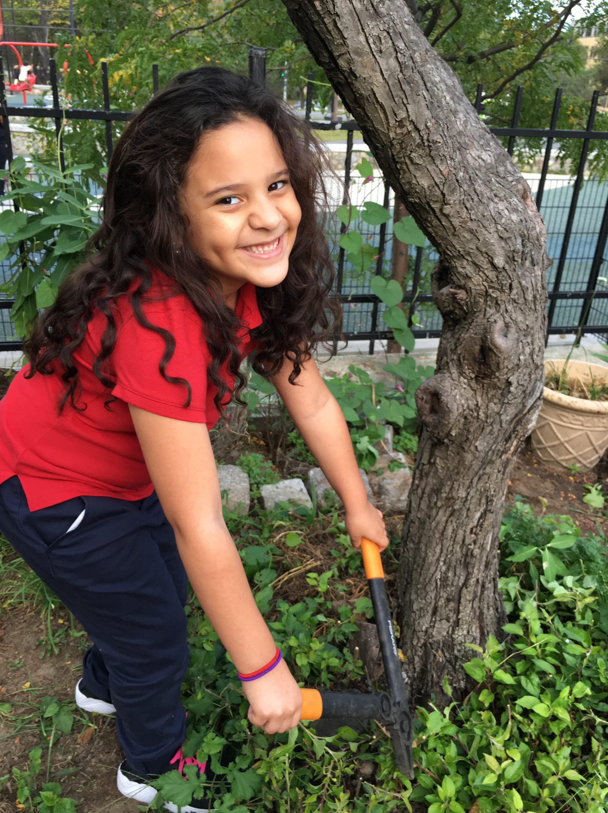
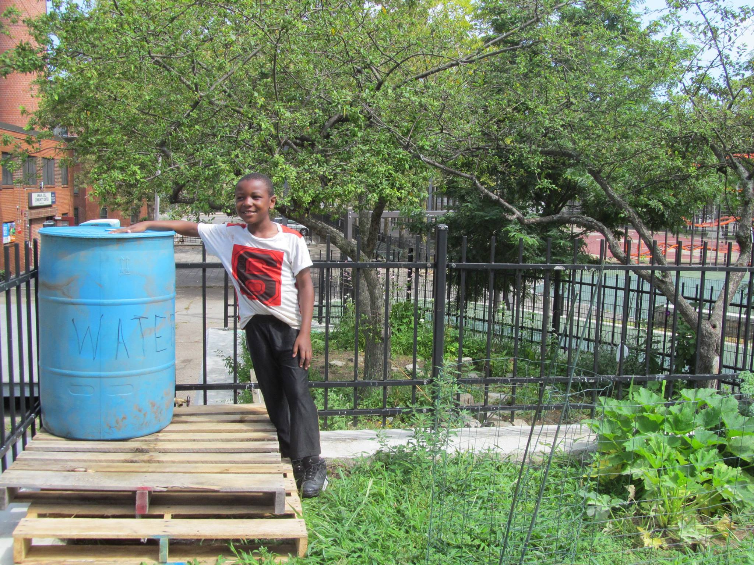
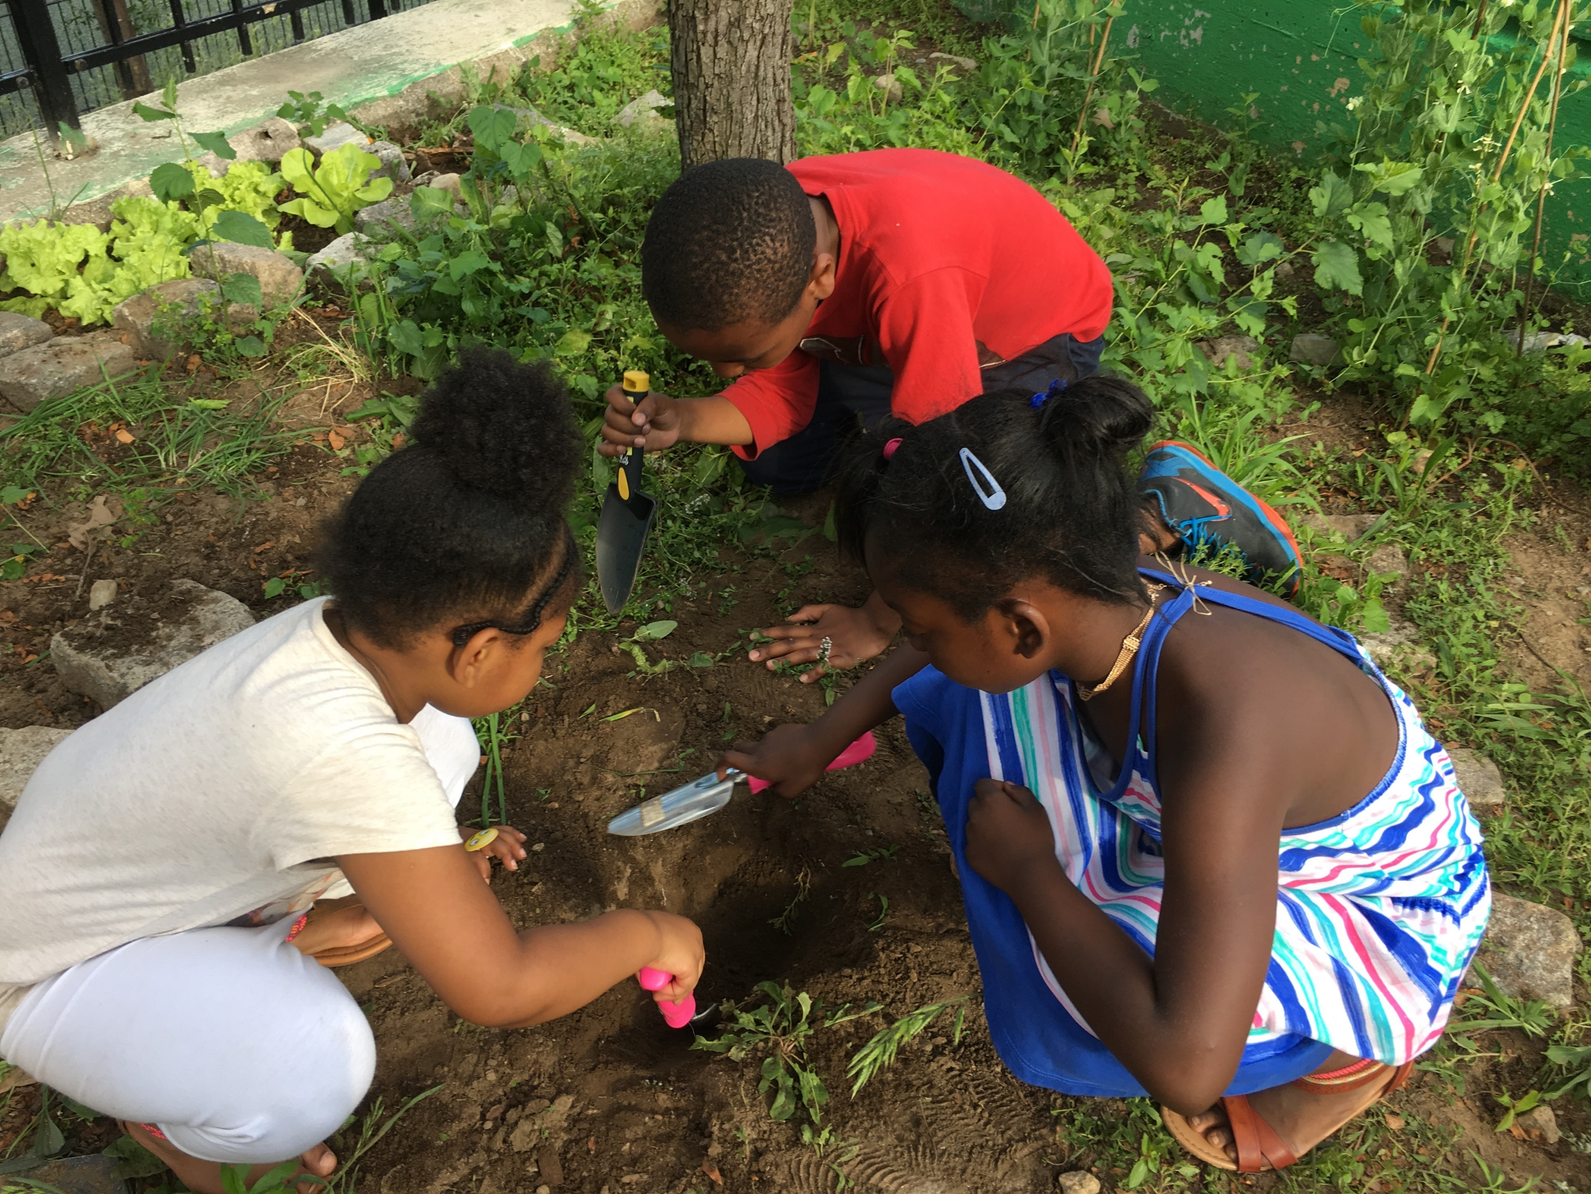
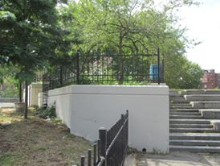
Jackson Square Children’s Garden
This is the second year of collaboration between RealKidz Boston and the Southwest Corridor Park, with weekly children’s garden activities in the Jackson Square Children’s Garden. The garden, located near the Lorber Family Playground, features mint, borage, clovers, strawberries, squash and watermelon plants, kale, cucumbers, and a variety of flowers.

Slide 23
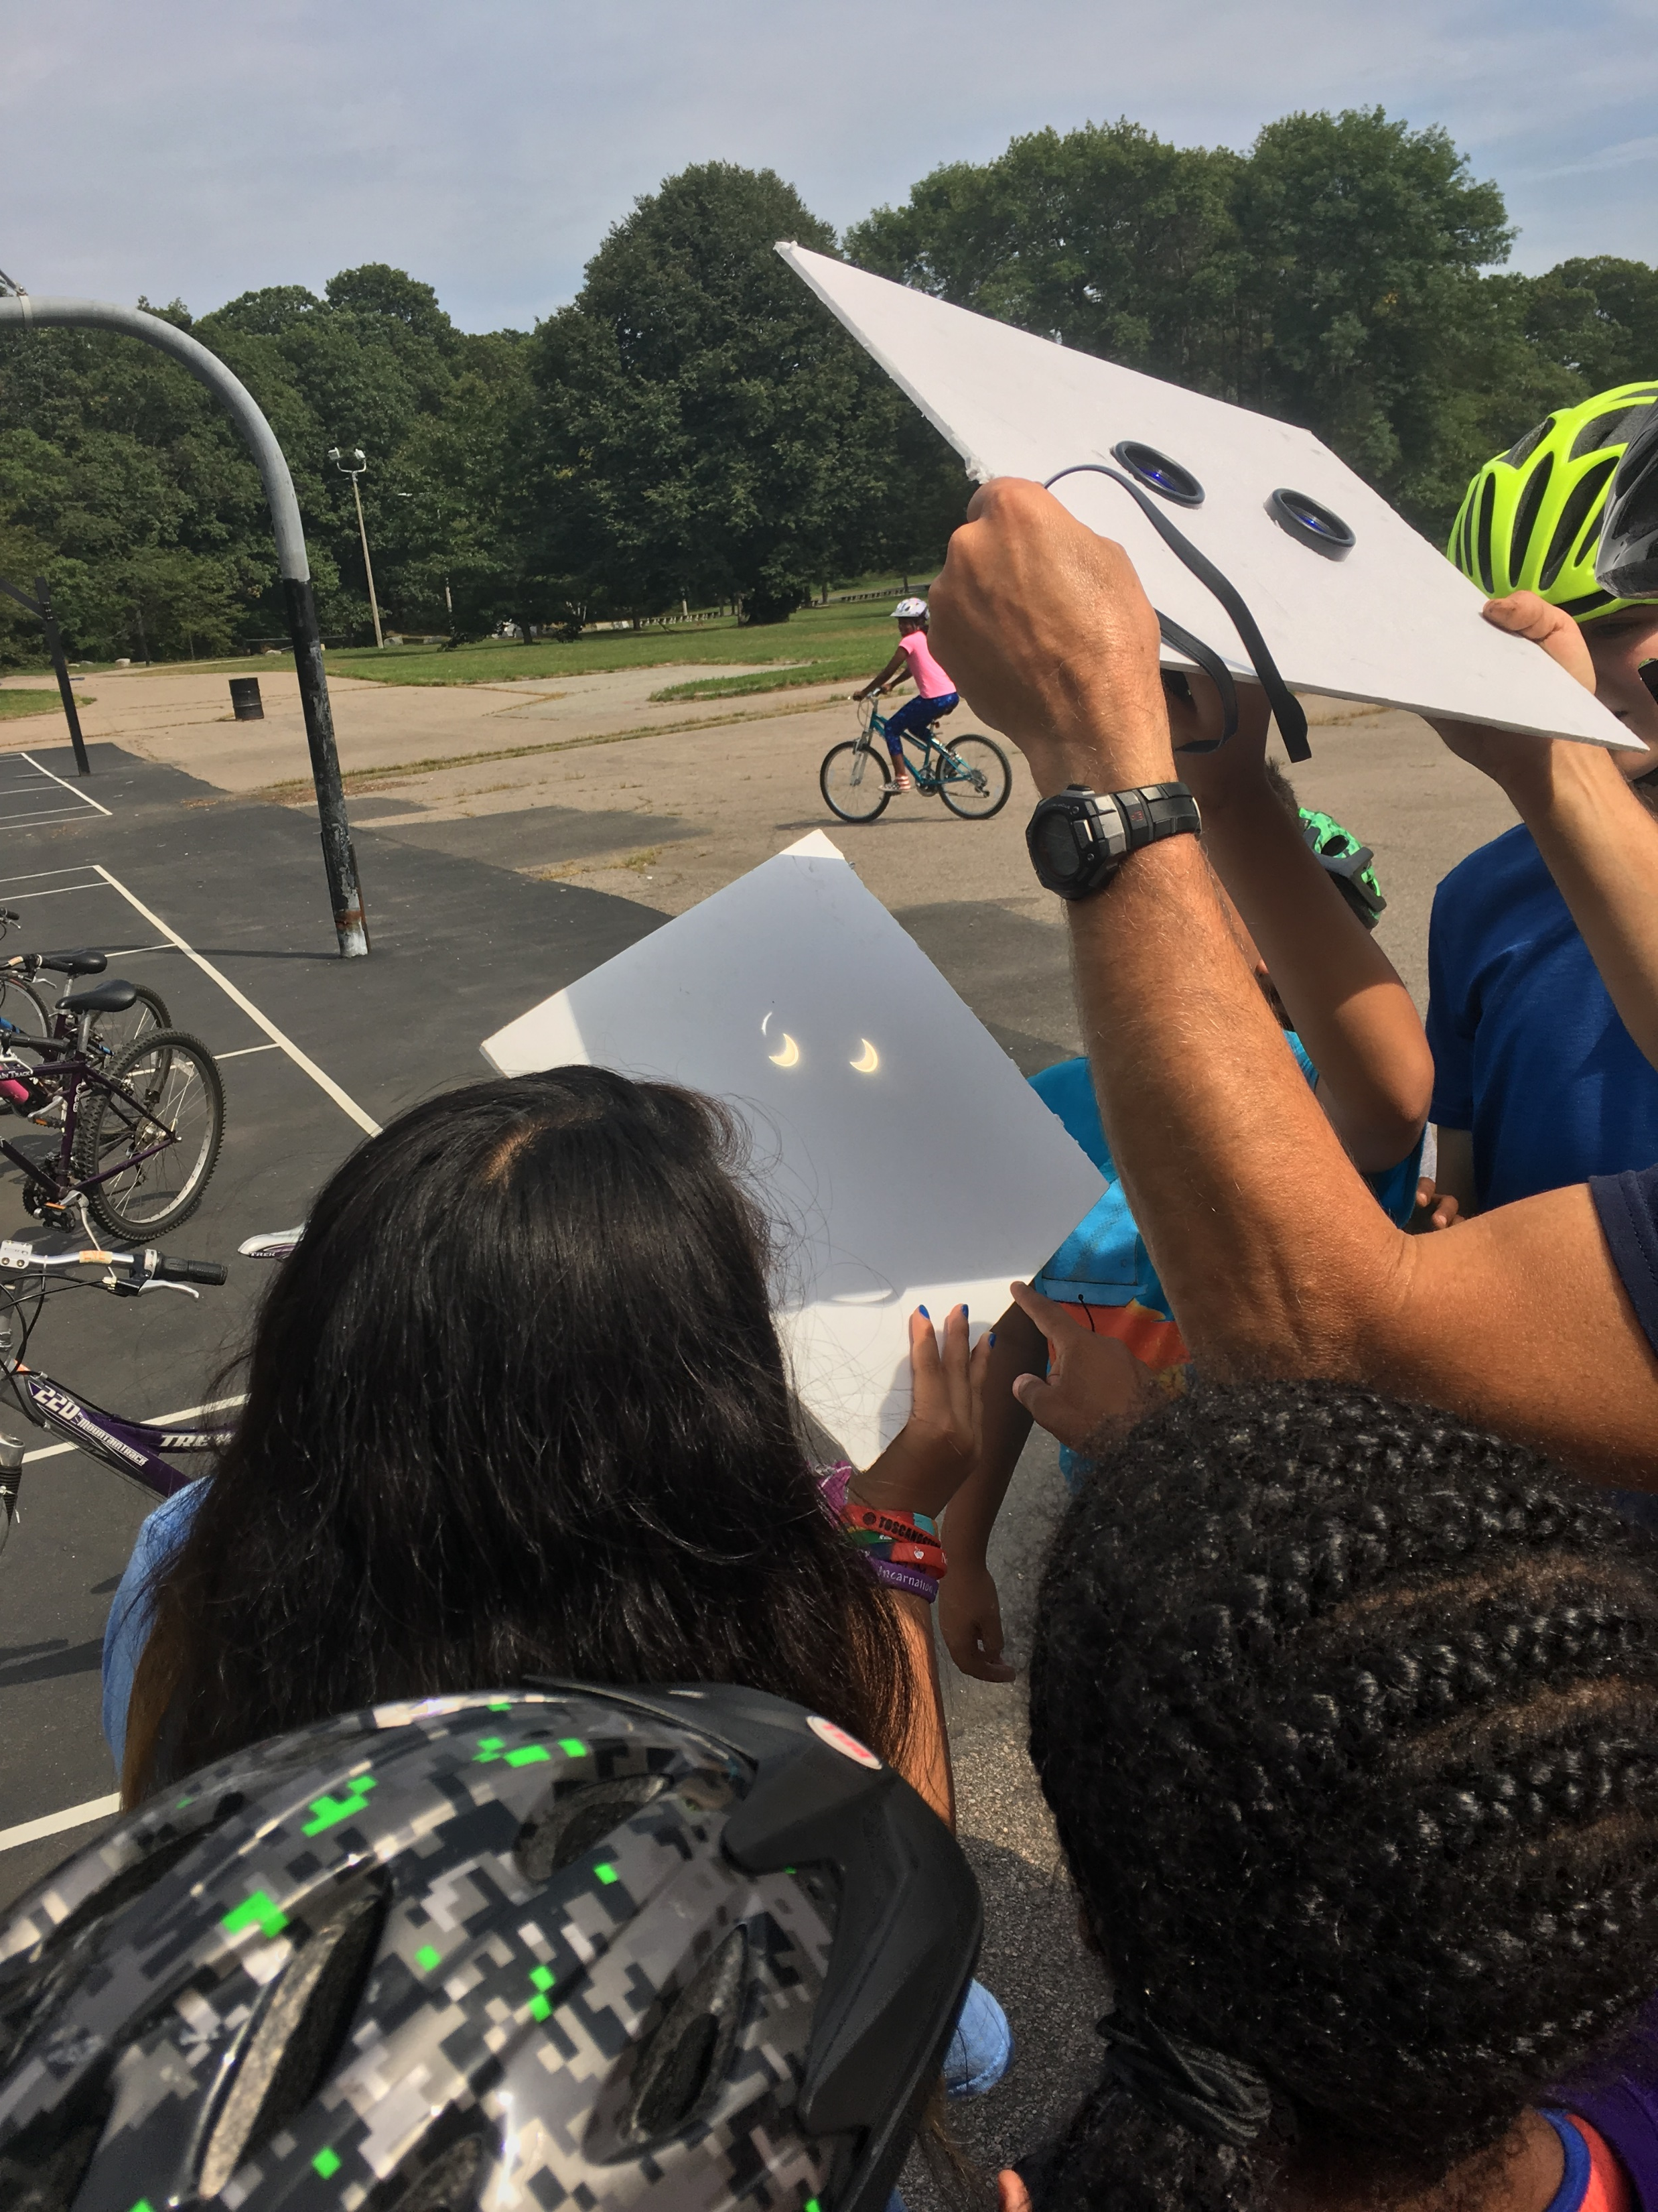
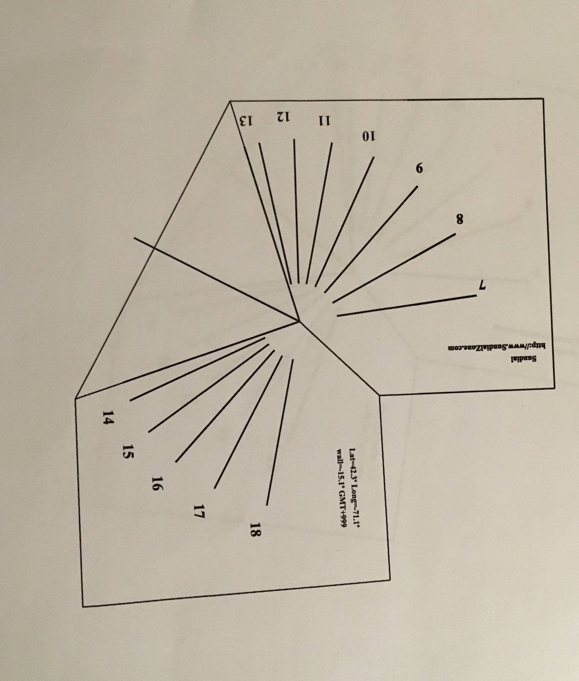
Sundials, Solar Energy and the 2017 Solar Eclipse
The Boston Explorers Bike Week included an opportunity to view the 2017 Solar Eclipse.
Complemented by a “Science Wednesday” program, children working in the Children’s Garden also learned about solar energy, sundials and the solar eclipse this year.

Slide 24
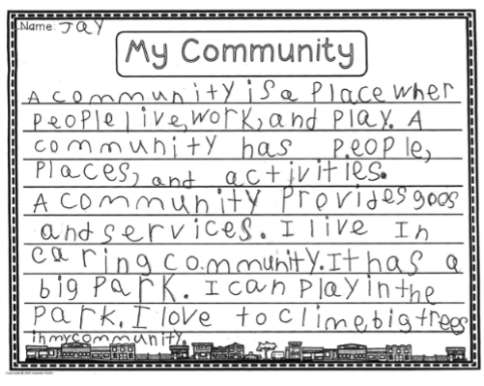
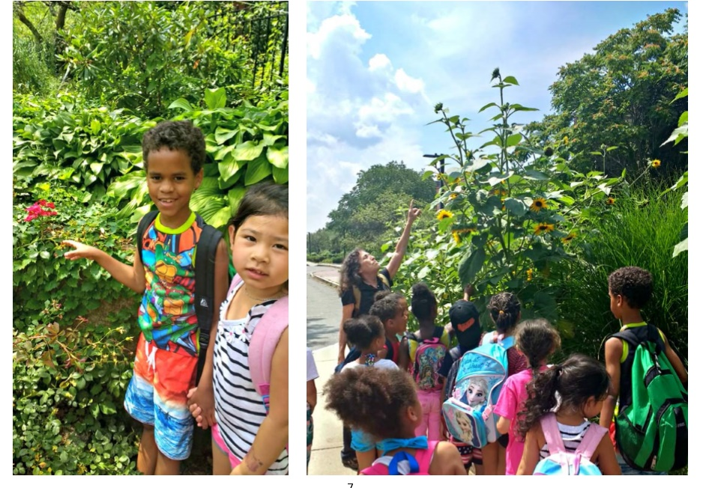
IBA – Exploring Community

Slide 25
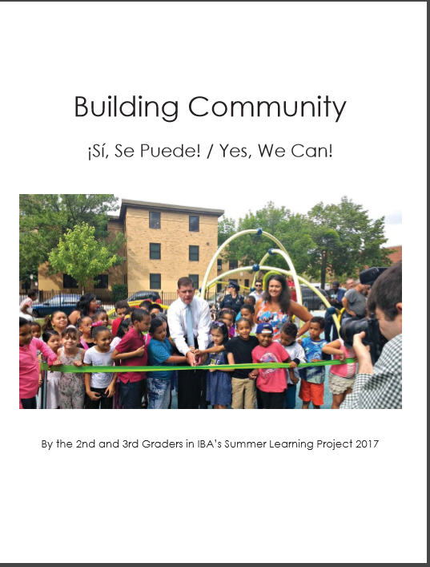
IBA – Exploring Community

Slide 26
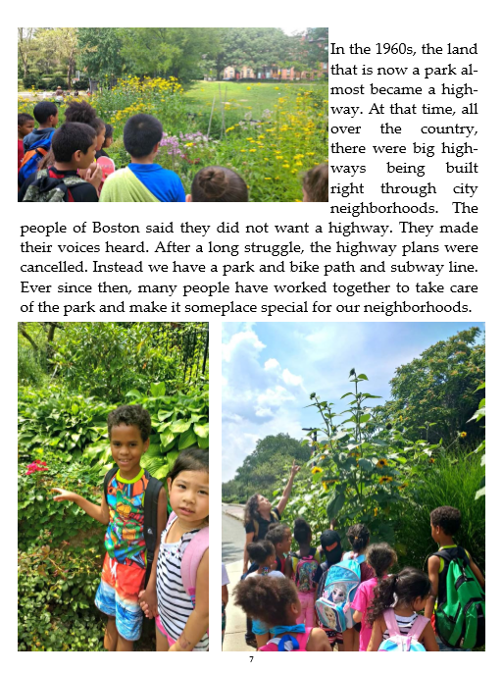
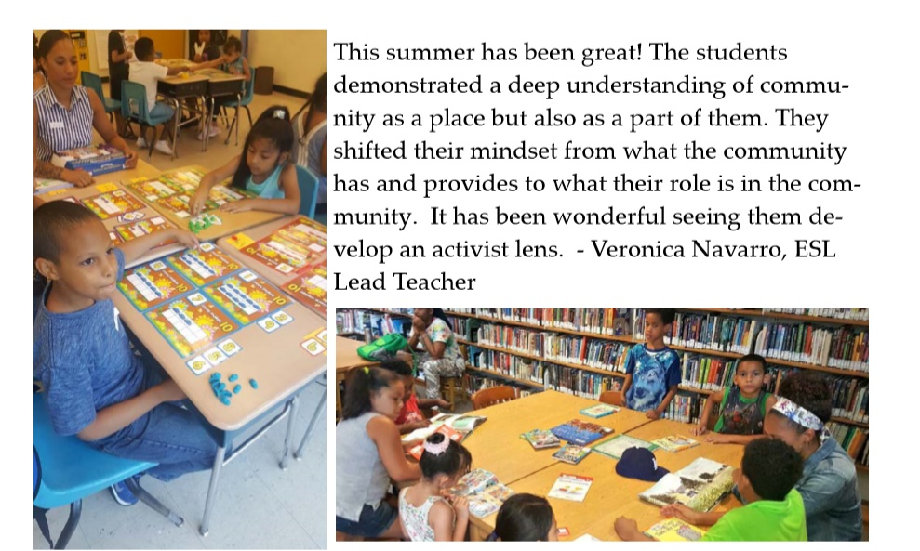
IBA – Exploring Community

Slide 27
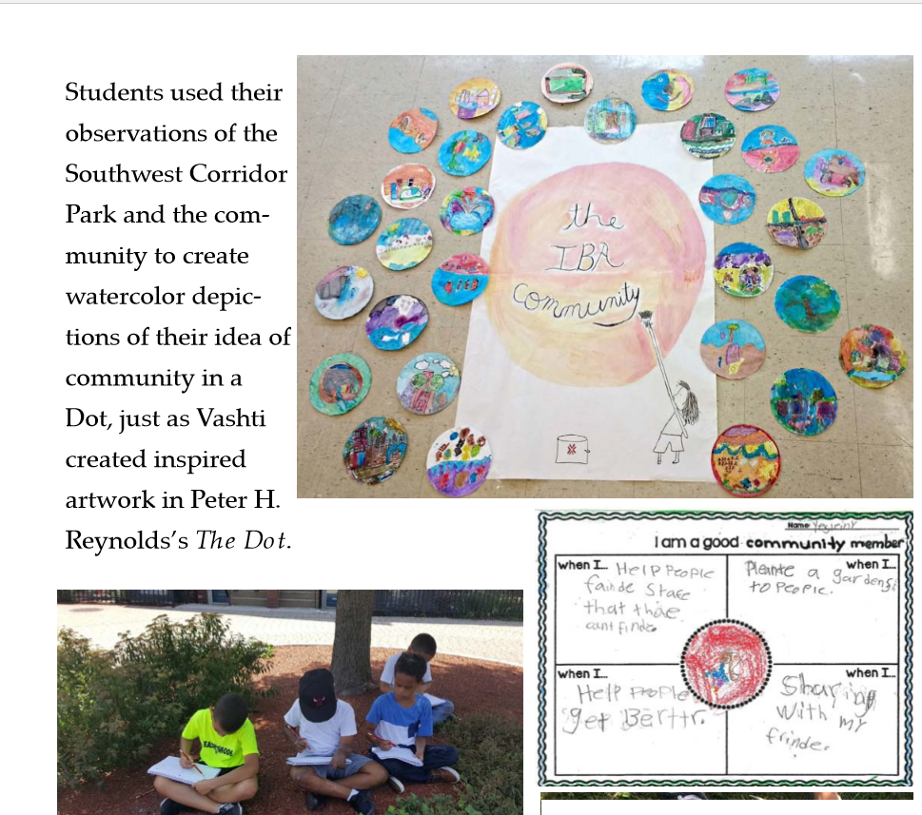
IBA – Exploring Community

Slide 28
Community Partnerships

Slide 29
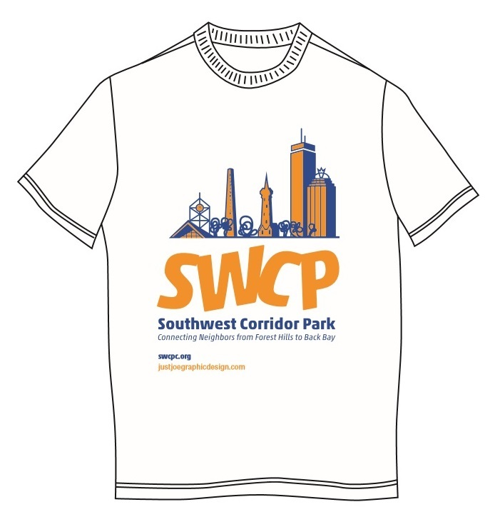
Community Partners
The SWCPC works with BostonCares to create a calendar of park volunteer days and many hours are provided in the park by BostonCares volunteers.
PMAC members have participated in Boston Park Advocates events and Environmental League of Massachusetts advocacy work; members have also followed the development of the neighboring Roxbury Heritage Park.
The Bicycle/walking path subcommittee is working with City of Boston, Northeastern University and DCR to advocate for path improvements.
Northeastern University’s City and Community Affairs continues to be a strong partner, including support for mini-grants, participation by students in PMAC meetings and SWCPC volunteer days. The PMAC co-chair is a member of the NEU CAB Advisory Board.
Community Partners

Slide 30
Community Partners
Neighborhood groups are key partners, looking at issues including development, housing and open space, homelessness and public safety.
PMAC members who are members of South End neighborhood groups have participated in a neighborhood task force on homelessness and addiction.
The rapid pace of development in Boston has brought more focus on the impact of development on the SWCP and surrounding neighborhoods.
Local and state politicians are supportive of the work we do in the Southwest Corridor Park and we continue to build and nurture these relationships.
Community Partners

Slide 31
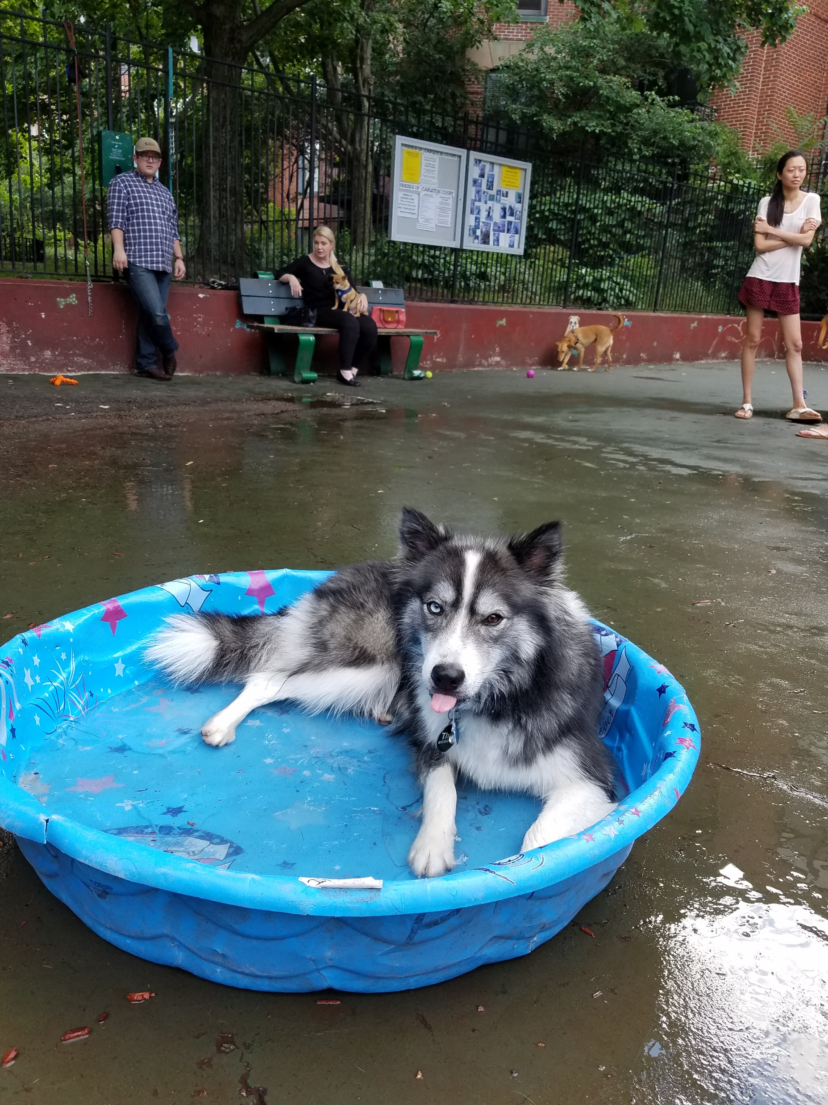
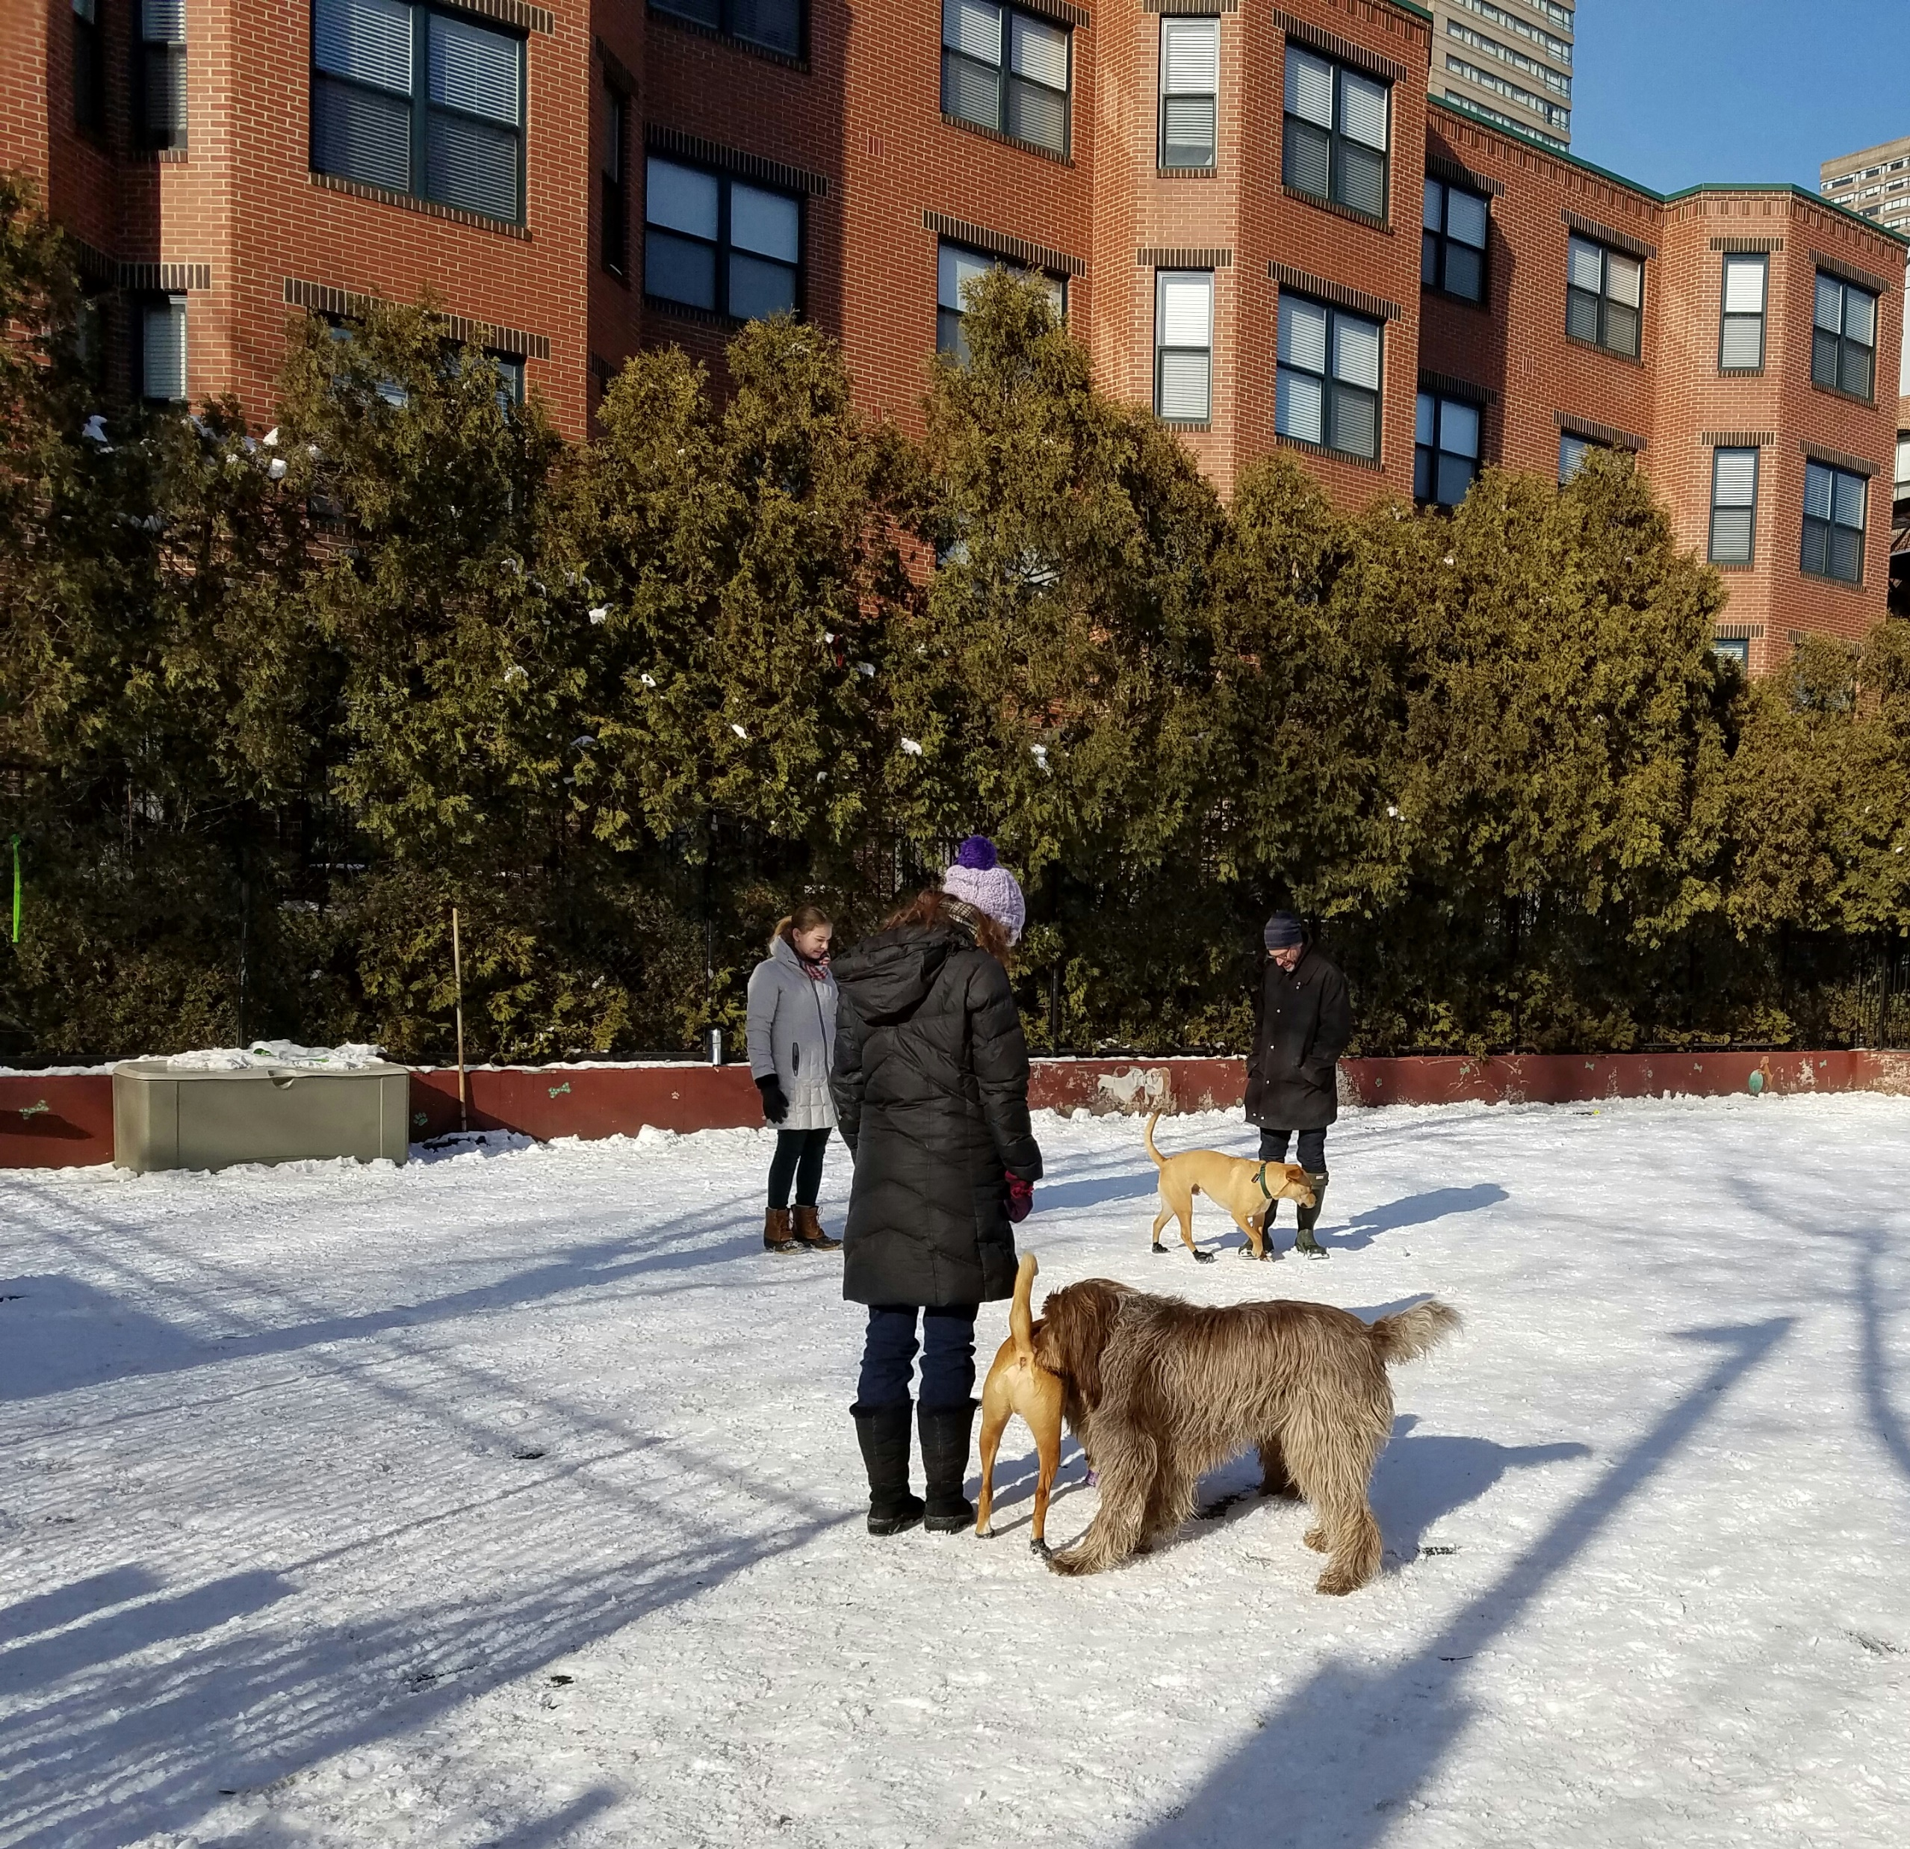
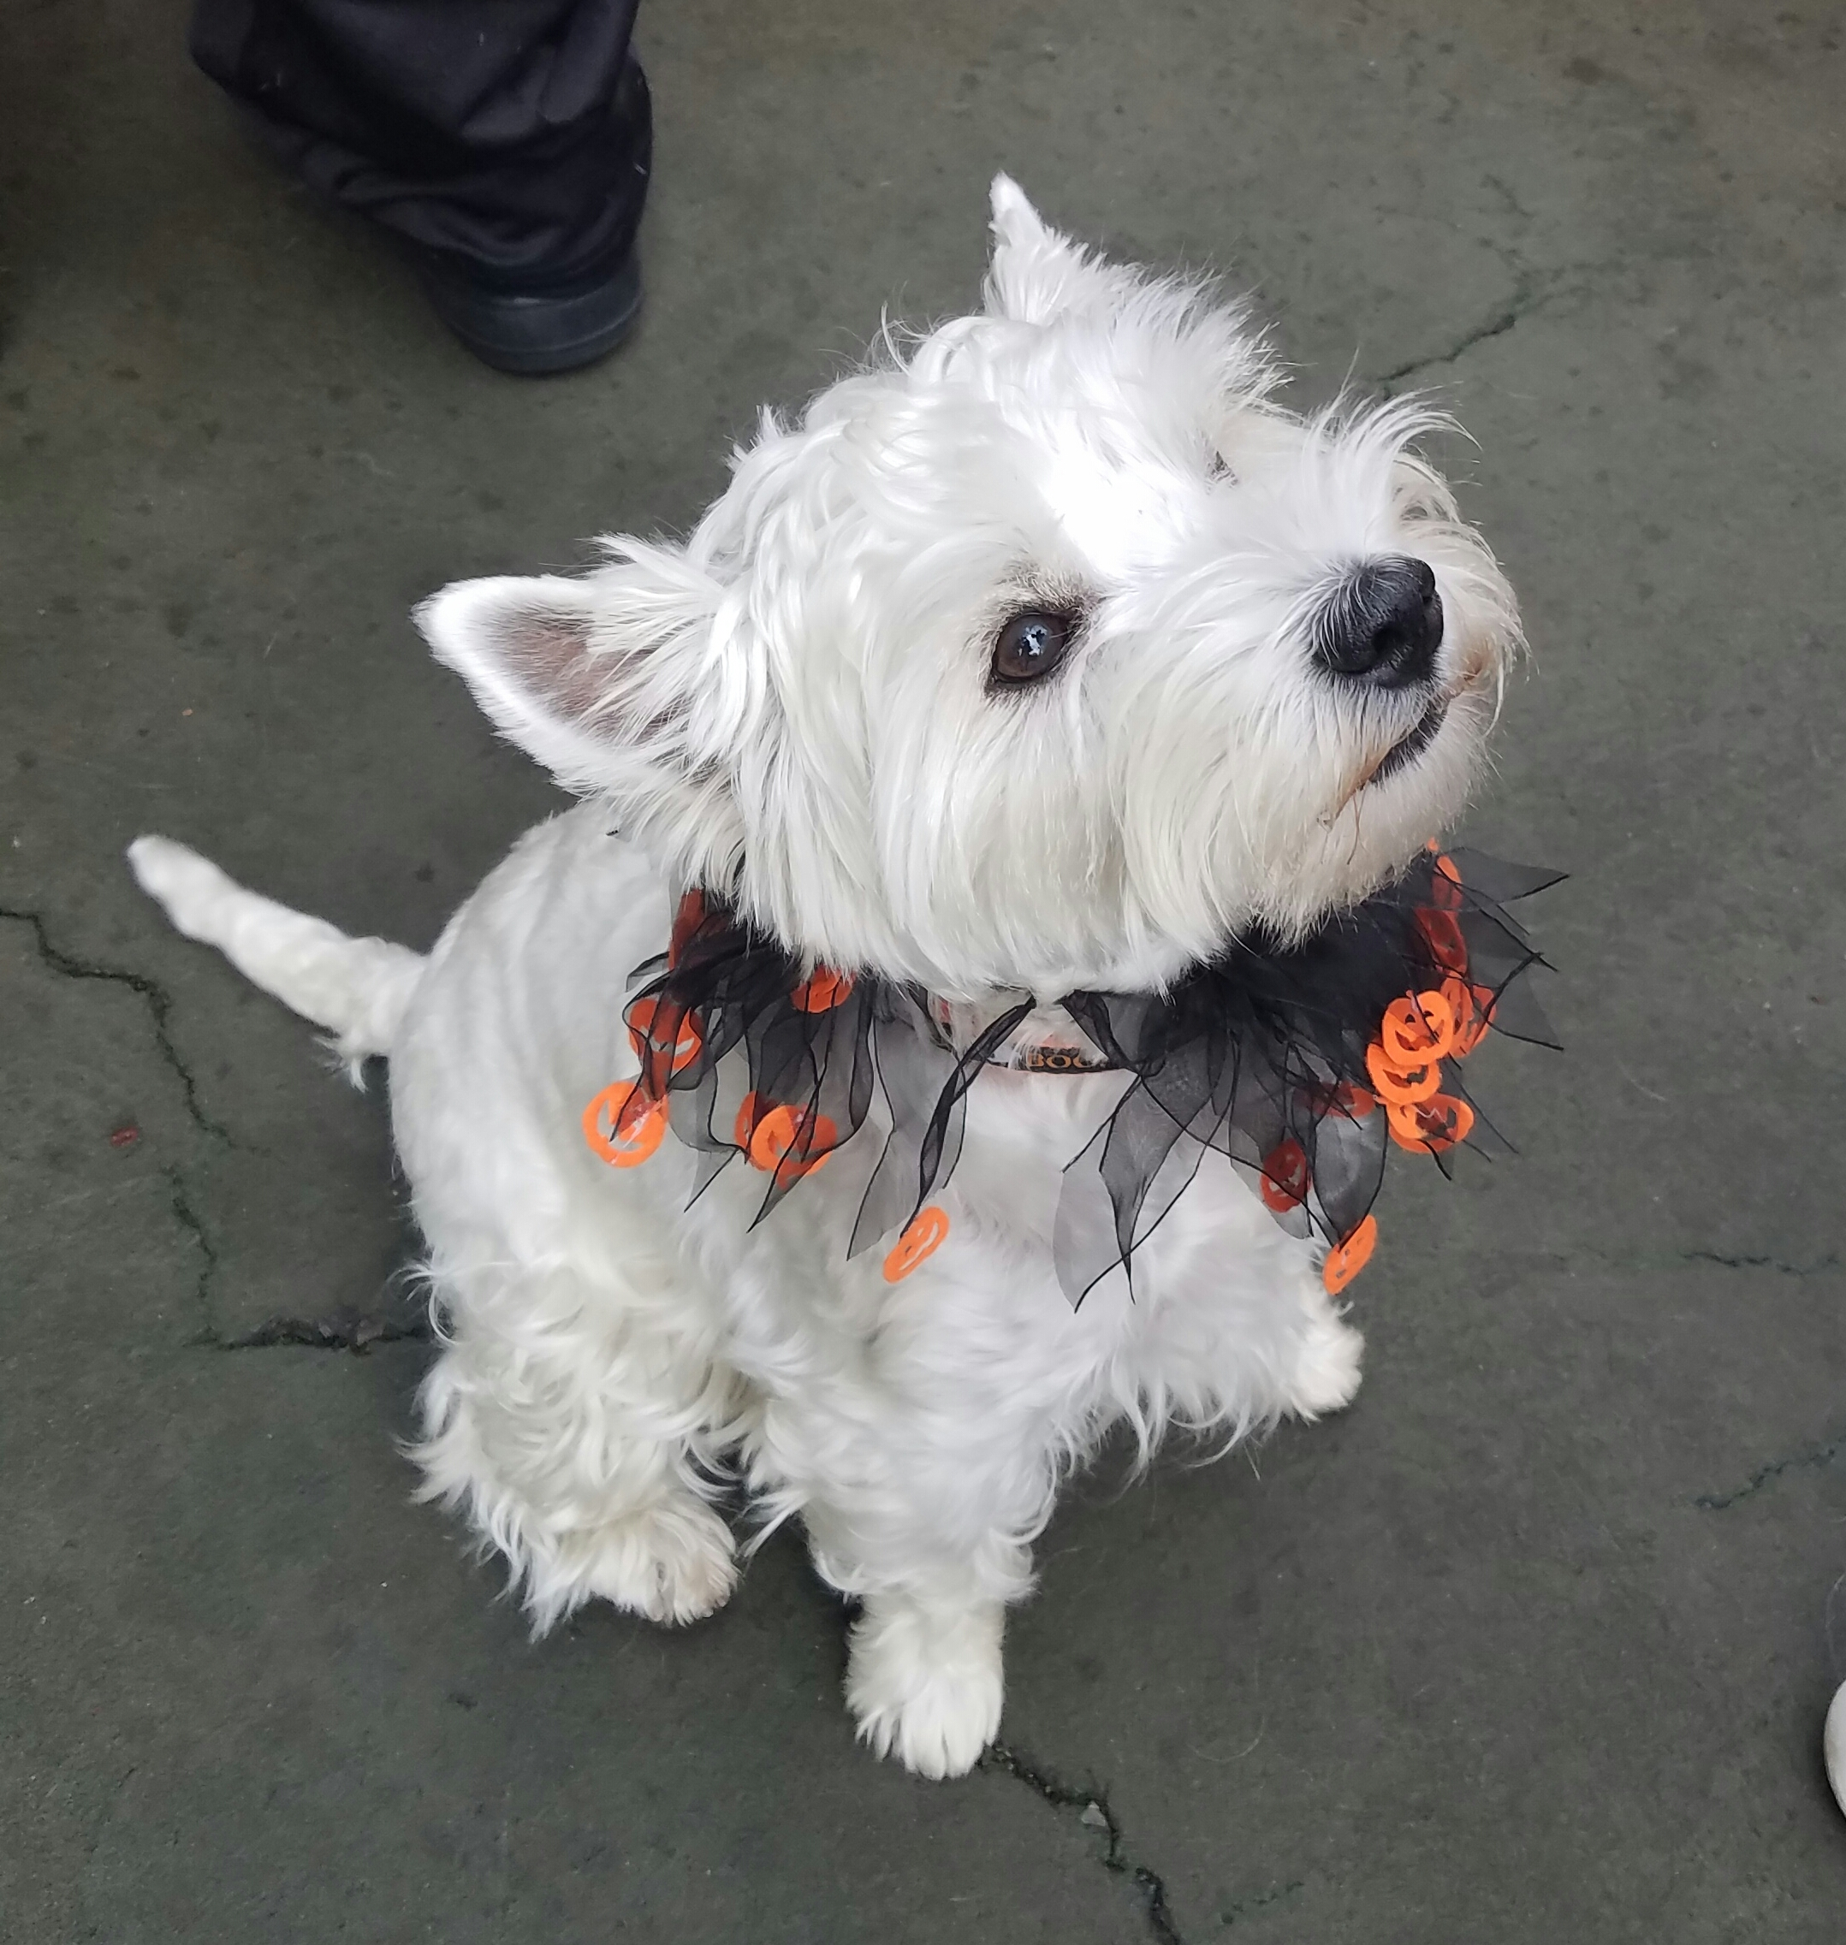
Dogs and Dog Parks
The Carleton Court Dog Park continues to support the dog park in the South End / Back Bay, with ongoing fundraising, maintenance and education.
PMAC members, including the Carleton Court Dog Park volunteers, SWCPC coordinator for JP and others, have supported an advocacy effort for finding a dog park location in JP.

Slide 32
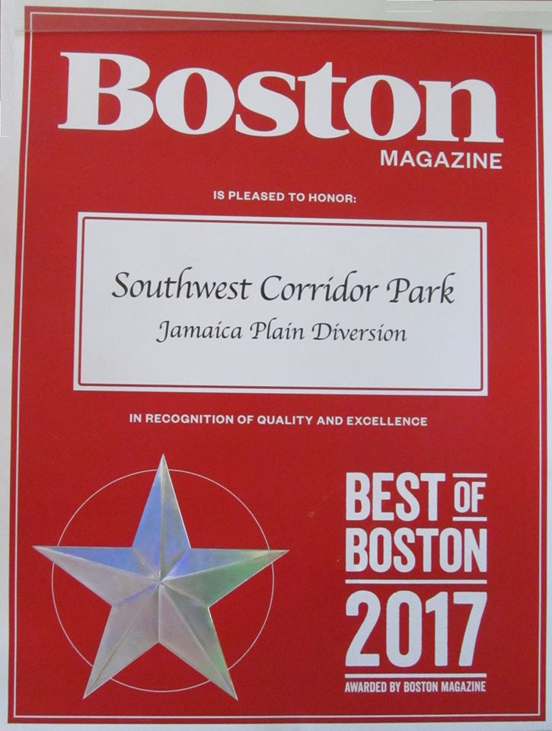

Slide 33
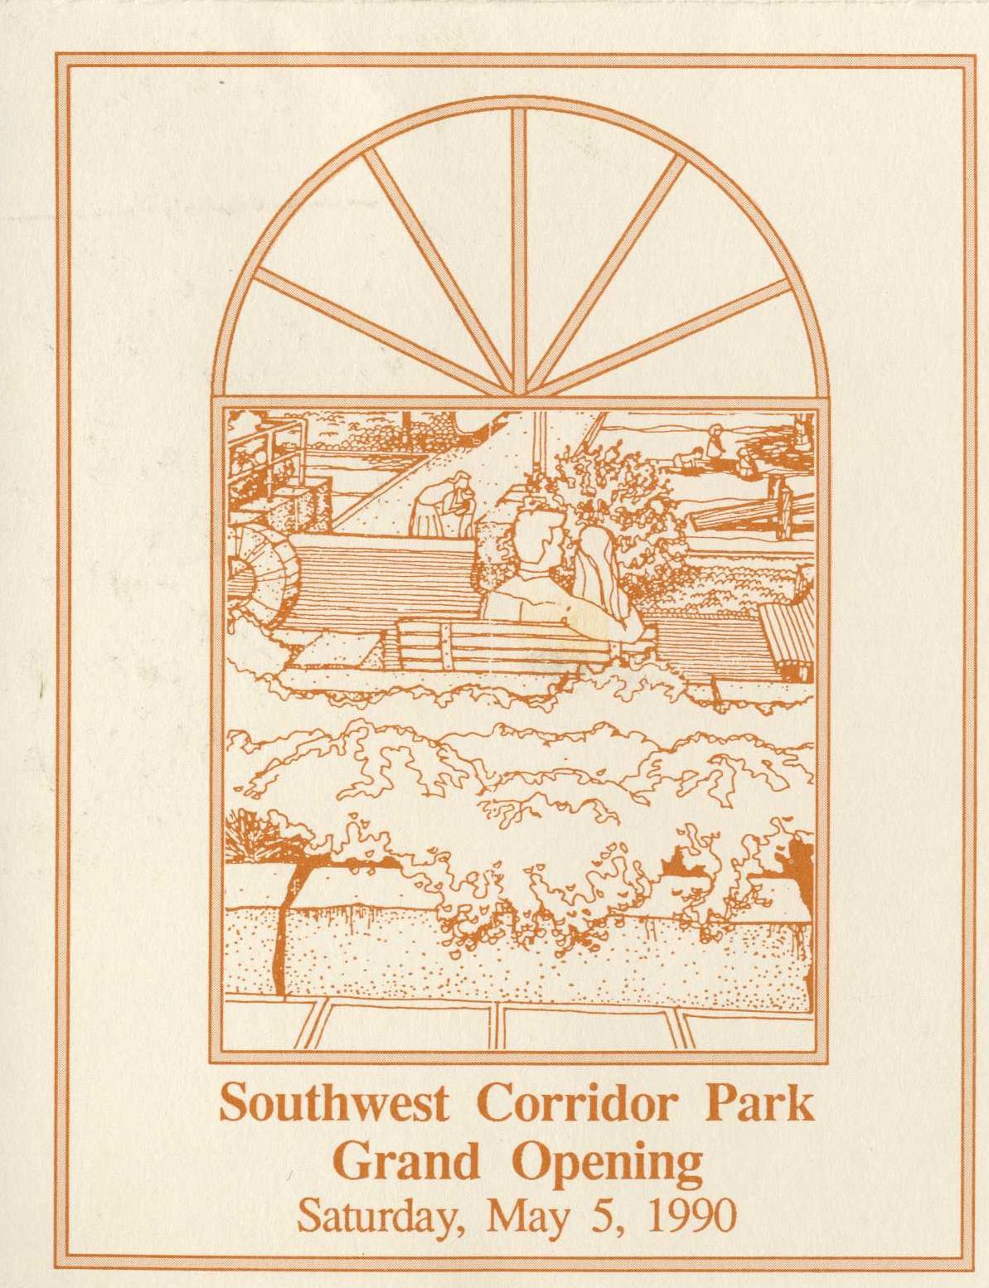
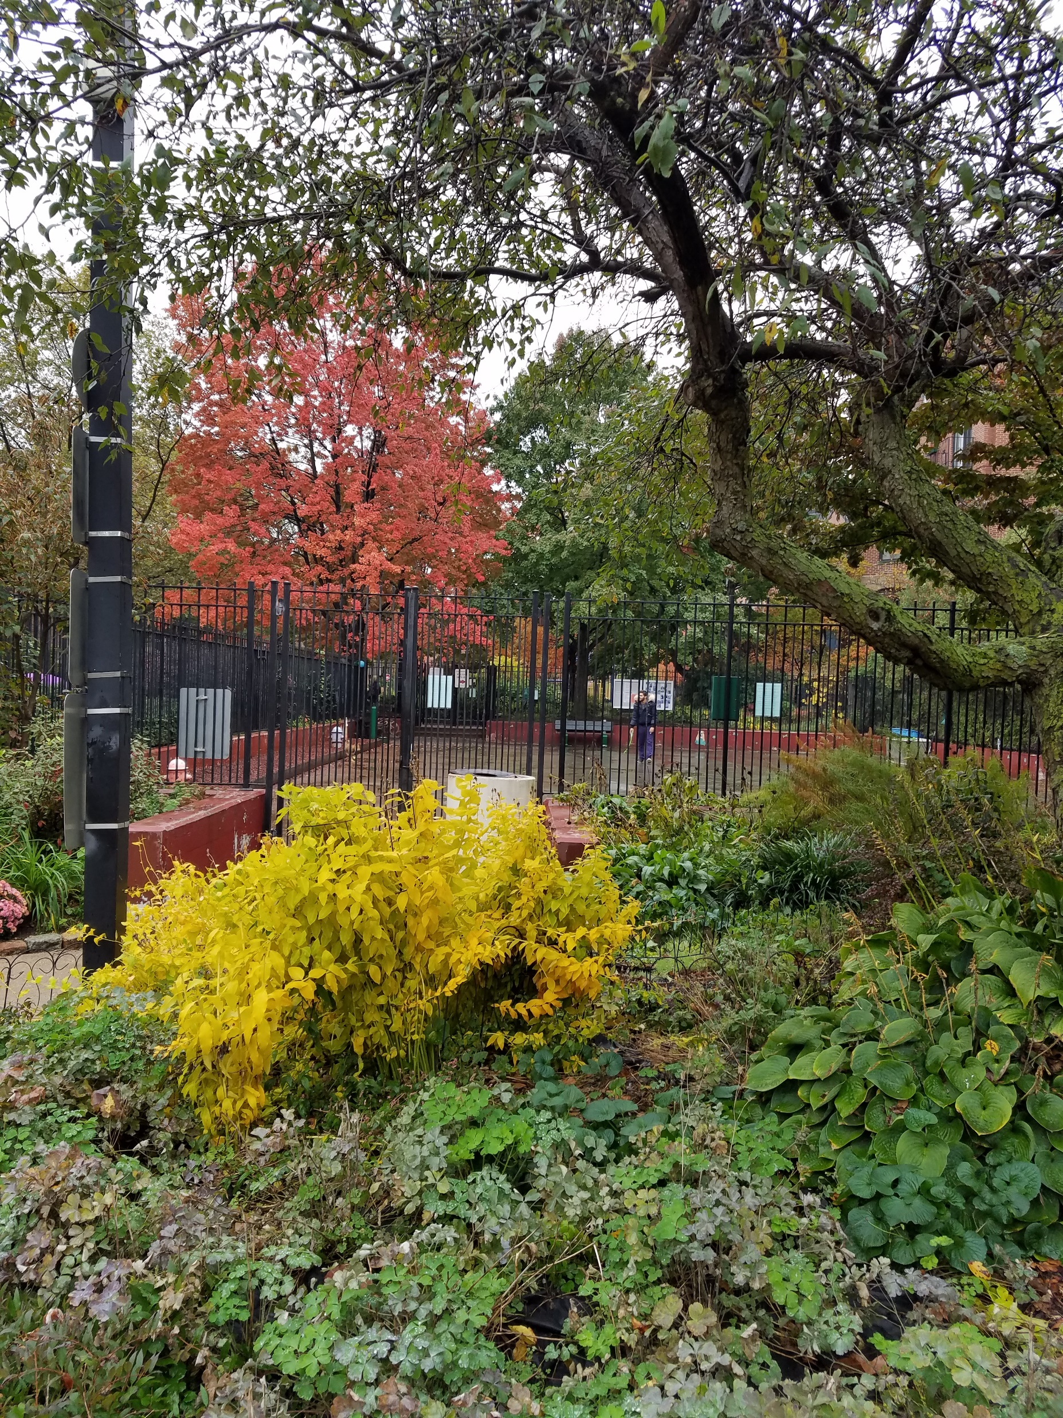
For more information visit our website or follow our social media pages. Visit http://swcpc.org

Slide 34
Small Group Exercise
In Small Groups:
Define some criteria for evaluating goals… make up icons for criteria:
Such as:
(SH) = Short-term, achievable;
(HI)=High importance;
(CV)=Community Value
(Vol)=Volunteer-Led
(DCR)=DCR Led
List goals on post-it notes
Sort & classify

